Slide 1
COLUMBIA ANALYTICS PROJECT:
Vespucio Free-Flow Toll Collection
Michelle Peng
Kris Chen
Vidhi Agrawal
Howard Yu
Raphael Barthes

Slide 2
TABLE OF CONTENTS
Part 3: Predictive Model: Data EDA
3.1 Vespucio Data EDA
Part 1: Project Overview
3.1.1 Payment Behavior Consistency
3.1.2 Toll Fee Amount vs. Payment Behavior
3.1.3 Document Type vs. Payment Behavior
3.1.4 Product Type vs.Payment Behavior
3.1.5 Payment Delay vs. Payment Behavior
1.1 Project Background
1.2 Goals and Progress
1.3 Data Sources
Part 2: Macroeconomic Correlation Analysis
3.2 Equifax Data EDA
2.1 Univariate Correlation
3.2.1 Equifax Score vs.Payment Behavior
3.2.2 Equifax Levels vs. Payment Behavior
2.1.1 Approach
2.2 Univariate Correlation: Analysis
2.2.1 General Economic Conditions
2.2.2 Inflation
2.2.3 Household Conditions
2.2.4 Urban Transportation
Part 4: Predictive Model
4.1 Building the Prediction Model
4.1.1 Logistic Regression & Random Forest
4.1.2 XGBoost & LightGBM
4.1.3 Diving into Predictions
4.1.4 Next steps
2.3 Multivariate Correlation
2.3.1 Approach
2.3.2 Variable Observation and Processing
2.3.3 Feature Selection and Regression
2.3.4 Model Compare and Contrast
2.3.5 General Conclusions and Explanations
4.2 Cluster Analysis
4.2.1 Variable Selection
4.2.2 K-means Clustering

Slide 3
Part 1: Project Overview
1.1 Project Background
Problem Overview
Toll Evasion Increase: Urban toll road systems, particularly in Chile, face difficulties with efficient toll collection. There has been a notable rise in toll evasion rates, with default rates escalating from 4% to 20% post-pandemic, resulting in potential decreased in the bottom-line.
Need for Data-driven Insights: The recent implementation of the cloud data warehouse opens the door to new data driven methods to assist decision making on collection.
Project Goal and Objectives
Macroeconomic Analysis: Examining the impact of economic trends on payment delays to better understand what part of the increase is controllable.
Predictive Model Development: To forecast likelihood of payment default and estimating payment timings for each consumer, and identify optimal collection agency involvement.
Potential Impact
Re-evaluation of Toll Rates: Leverage macroeconomic insight to aid in strategic negotiations regarding fixed toll pricing.
Improved Revenue Efficiency: Enhance toll revenue collection by preempting and managing defaults effectively.
Sustainable System Maintenance: Develop a data-driven approach that can be used following our team’s involvement in the project.

Slide 4
Part 1: Project Overview
1.2 Goals and Progress
Our goals are structured around two primary focus areas: Macroeconomic Correlation Analysis and Predictive Modeling.
Macroeconomic Correlation Analysis
Objective: To assess impacts of various macroeconomic indicators on defaults rates.
Macroeconomic Indicators:
Classified into 4 categories: Overall Economic Health, Inflation, Household conditions, and Urban Transportation
Sourced from organizations including FRED, the World Bank, IMF, Central Bank of Chile,and the National Statistics Institute of Chile.
Data Sources: Detailed in following slide.
Methodology:
Univariate Regression (OLS): Analyzing individual macroeconomic indicators against % default rate.
Multivariate Regression (OLS): Combining significant indicators from each category to explain default rates.
Predictive Model
Objective: To forecast individual default likelihood.
Vespucio Dataset:
Comes from the Vespucio data project led by Stratify, advised by Ardian’s IT and Data Science team.
Contains 482 million transactions with automated data processing and updates,
Includes detailed information on customer characteristics, behaviors, and payment details.
Equifax Dataset:
Comes from a joint venture between Equifax ID Patrol™ and the Chilean Government,
Includes detailed information on consumer credit scores.

Slide 5
In Summary
Macroeconomic Analysis
Univariate Model:
In our univariate analysis, we explored the influence of carefully chosen macroeconomic indicators on toll payment defaults, employing a series of OLS models with moving averages to account for autocorrelation. Our findings highlight the economic relationships across 4 major categories, and can help stakeholders anticipate and mitigate risks associated with toll leakage more effectively.
The GDP model for Overall Macroeconomic Health, utilizing a 33-month moving average, explained 58.2% of the variation in defaults, with a significantly negative GDP coefficient indicating that a decrease in GDP correlates with an increase in defaults. Despite some residual autocorrelation, the model's validity is supported by an F-statistic of 77.83.
For the Inflation category, we applied a 31-month moving average to the Chilean CPI, which accounted for 84.8% of the default rate variance. The positive CPI coefficient suggests that higher inflation levels are associated with increased default rates, validated by an F-statistic of 257.
In the Household Conditions category, a 12-month moving average of household debt as a percentage of GDP showed an R-squared of 0.874, with debt increases aligning with higher default rates. This model's strong predictive power is underscored by its F-statistic of 27.76.
Lastly, the model analyzing Urban Transportation through the Santiago Passage Index used yearly data and explained 62.4% of the variance in defaults. The positive correlation between increased traffic volumes and default rates was significant, reinforcing the importance of traffic trends in predicting toll defaults.
Multivariate Model:
In our univariate analysis, we developed four distinct models, each utilizing a different set of variables to interpret various aspects of the macroeconomy. Our study reveals the intricate link between economic indicators and default rates, and the integration of comprehensive data sets enhances our ability to understand financial trends and stability with different variables.
Default Rates tend to remain high irrespective of economic conditions
There is a negative correlation between Chilean GDP and default rates, suggesting periods of economic growth are associated with reductions in default rates, underscoring the impact of economic expansion on financial stability
Higher inflation levels are associated with increases in default rates, suggesting that inflation can place on borrowers' ability to meet debt obligations
The variance observed between Santiago GDP and national GDP indicates significant regional economic disparities. Therefore, integrating both regional and national economic indicators into our models has provided a more nuanced understanding and improved the robustness of our findings.

Slide 6
In Summary
Predictive Model
Explanatory Variables: The predictive model targeted the variable Unpaid, where '1' represents unpaid invoices (Impaga and Castigado) and '0' represents paid invoices (Pagada). The model utilized 14 explanatory variables, with ImportePesos (Transaction Amount), Score Equifax (Credit Score), Number of Vehicles, Number of Contracts, and Customer Lifespan emerging as the most influential in predicting defaults. The analysis revealed regional differences in default probabilities, with some regions showing a higher propensity for defaults based on historical data. This underscores the significance of geographical factors in risk assessment.
Model Performance: The classification models achieved an average accuracy of 88%, with a precision of 70% and a notably lower recall of 15% (XGBoost). The lower recall rate is a critical issue, reflecting the model's limited capability in identifying all actual unpaid invoices, which is a significant concern for the business.
Challenges with Recall: The primary challenges affecting recall include a high data imbalance, which leads to a bias towards predicting invoices as paid, the presence of noise, and a lack of more predictive variables that can effectively distinguish between different user characteristics. We recommend the following changes for improvement:
Data Balancing Techniques: Use techniques to improve class composition in training data to enhance recall.
Quality Check on Data Ingestion: Ensure the data ingestion pipeline is free from noise that could degrade model performance.
Inclusion of Macro-Economic and Demographic Variables: Integrate macroeconomic factors related to different cities and customer demographic data such as age, gender, and marital status. This can enrich the model’s context and provide deeper insights into default risks.
Enhancing Payment Behavior Features: Improve feature engineering by developing more precise features that accurately reflect users' historical payment behaviors
Cluster-Specific Models: Develop targeted models for identified customer clusters to reduce noise and improve detection accuracy.
Enhanced Time-Series Analysis: Implement a more detailed analysis to capture seasonality in defaults.

Slide 7
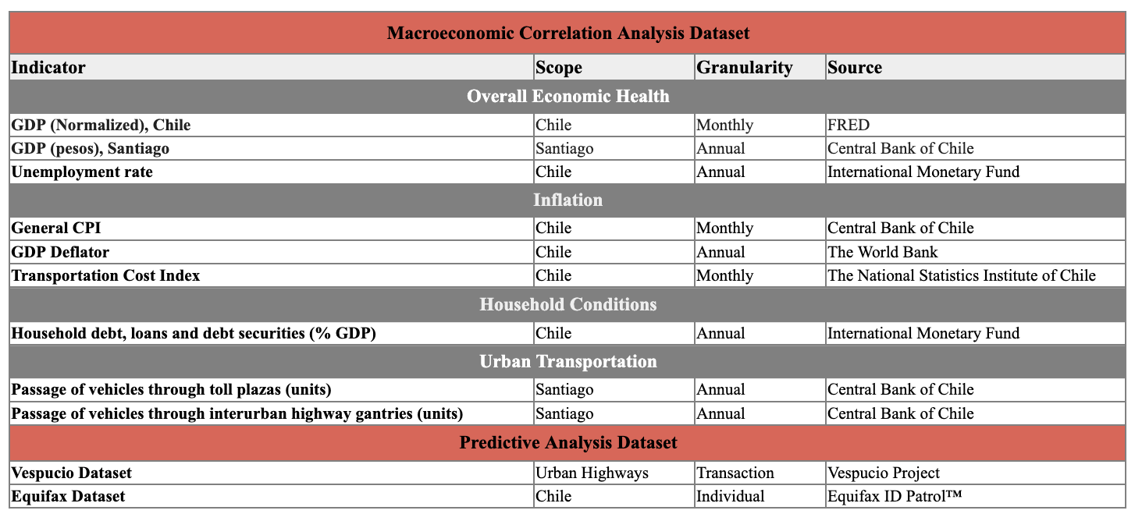
Part 1: Project Overview
1.3 Data sources

Slide 8
Part 2: Macroeconomic Correlation Analysis
2.1 Univariate Correlation
2.1.1 Approach
Objective: For each macroeconomic indicator category, identify the most effective indicator that explains default rates.
Approach: Conduct a series of statistical analyses using Ordinary Least Squares (OLS) regression and other methods.
Step 1 - Initial Regression Analysis
Method: Perform univariate OLS regression on different macroeconomic indicators within given category, with default rate as dependant variable.
Adjustments: Standardize each indicator for scale and normalization to ensure unit comparability between default rate.
Purpose: Evaluate the initial relationship between each indicator and default rates.
Step 2 - Observations
Durbin-Watson Score: Use the Durbin-Watson statistic to check for autocorrelation in the residuals of the regression models.
Observation: High/low Durbin-Watson scores suggest autocorrelation problems for overall economic health, inflation categories,and household conditions.
Step 3 - Selecting Significant Indicators for Categories without Autocorrelation
Criteria: Focus on indicators that show statistical significance in their relationship with default rates.
Granularity: Prefer indicators with monthly/quarterly data over annual data to capture more detailed fluctuations and trends.
Step 4 - Further Analysis for Categories with Autocorrelation: Moving Average Model
Selected Variable: Continue analysis on the indicator showing the most promise within selected category.
Moving Average: Apply additional moving average modeling to the growth rate of the selected indicator to smooth short-term fluctuations and highlight longer-term trends.

Slide 9
Part 2: Macroeconomic Correlation Analysis
2.1 Univariate Correlation
2.1.1 Approach
Objective: For each macroeconomic indicator category, identify the most effective indicator that explains default rates.
Approach: Conduct a series of statistical analyses using Ordinary Least Squares (OLS) regression and other methods.
Step 5 - Further Analysis for Categories with Autocorrelation: Optimal Window Selection
Balancing Metrics: Choose the best window size for the moving average by balancing the p-value, Durbin-Watson scores, and window size (granularity).
Trade-off: A smaller window might provide less smoothing (higher p-value, lower DW score) while a larger window might over-smooth (lower p-value, higher DW score).
Step 6 - Further Analysis for Categories with Autocorrelation: Final Indicator Selection
Comparison: Compare the original variable and the growth variable (both smoothed).
Selection Criteria: Determine which version of the variable better predicts default rates, considering both statistical significance and autocorrelation control.
Final Variable Selections (Scaled):
Overall Macroeconomic Health: Chilean GDP (Monthly data), Moving Average
Inflation: Chilean CPI (Monthly data), Moving Average
Household Conditions: Household debt, loans, and debt securities (%GDP), (Yearly Data), Moving Average
Urban Transportation: Santiago Passage of vehicles through Toll Plazas (Units),(Yearly Data)

Slide 10
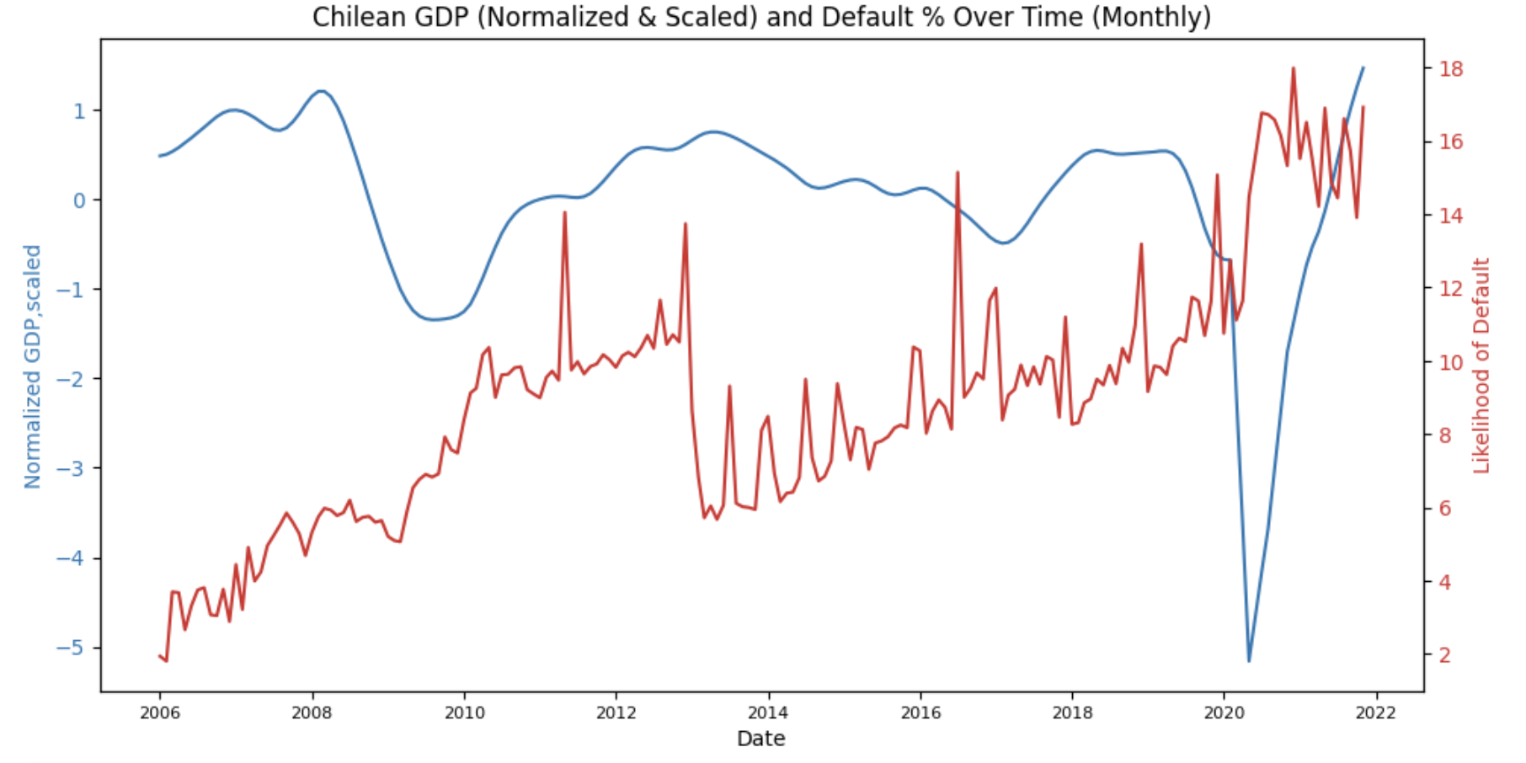
Part 2: Macroeconomic Correlation Analysis
2.2 Univariate Correlation: Analysis
2.2.1 Overall Economic Health: Chilean GDP
Graph Overview:
Blue Line: Represents the scaled and normalized GDP in Chile, showing general price level changes over time.
Normalization: adjusted by FRED (data source) to ensure data comparability across different time periods and conditions.
Red Line: Depicts the likelihood of default, likely on Chilean highways, demonstrating how default rates have changed over the same period.
Likelihood of Default: defined as the proportion of loans that are unpaid or written off, calculated monthly based on their issuance dates.
Key Observations:
Correlation Between GDP and Default Rates:
Indicates an inverse relationship between GDP and default.
As GDP decreases, the likelihood of defaults increases, particularly noticeable during economic downturns.
Economic Cycles and Impact on Defaults:
Economic downturns around 2008-2009, 2014-2015, and 2020 correspond with spikes in default rates.
The 2020 spike in defaults is particularly pronounced, reflecting the severe impact of the global pandemic.
Recovery Trends:
The post-recessions period following 2008, which show a recovery in GDP, correspond with a lagged decrease in defaults.
However, post-recession periods after 2014 do not show similar trends, as default rates continue to rise regardless of GDP growth.

Slide 11
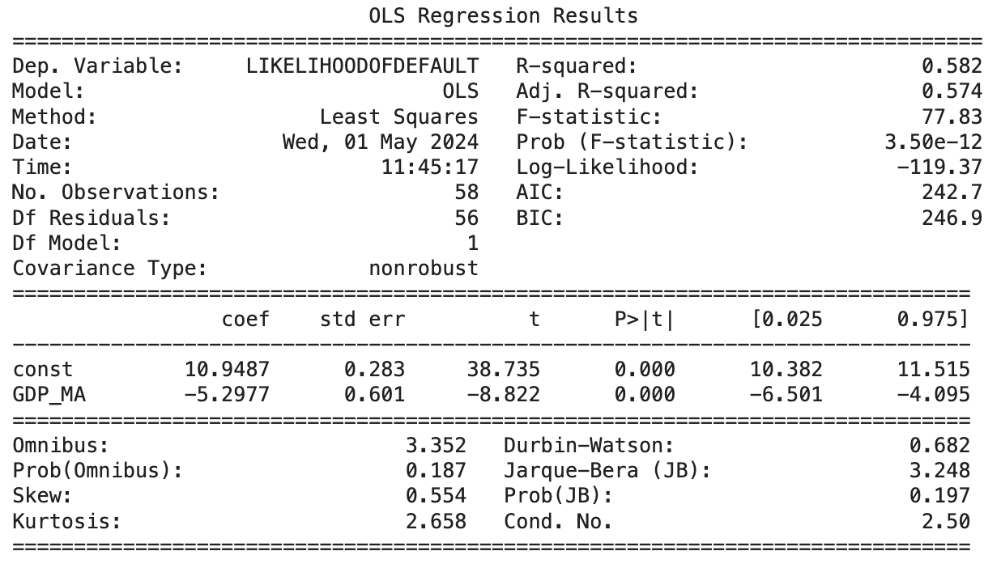
Part 2: Macroeconomic Correlation Analysis
2.2 Univariate Correlation: Analysis
2.2.1 Overall Economic Health: Chilean GDP
Regression Analysis with Moving Average
Independent Variable: Chilean GDP (Monthly), Moving Average
Units: Index, Normalized (Seasonally Adjusted) & Scaled
Granularity: Monthly
Window Size: 33
Dependent Variable: Default Rate
Units: % points
Granularity: Monthly
Summary of Results
Model Fit:
The regression model explains 58.2% of the variability in default rates (R-squared: 0.582), with an adjusted R-squared of 0.574, indicating a good fit using GDP moving averages.
The F-statistic is 77.83, with a very low probability (Prob (F-statistic): 3.50e-12), suggesting the model is statistically significant and the relationship between GDP and default rates is not due to random chance.
Coefficients:
Constant (Intercept): 10.9487 (p < 0.000), implying a high baseline likelihood of default irrespective of GDP.
GDP Coefficient: -5.2977 (p < 0.000), indicating a strong negative effect of GDP on default likelihood; as GDP increases, the likelihood of default significantly decreases.
Implications:
The optimal window of 33 indicates a 3-year lagged effect of GDP on default rates. The significant negative correlation between GDP performance and default rates suggests strong relationships between economic downturns and defaults.
Monitoring GDP trends can be a predictive tool for anticipating changes in default probabilities, crucial for economic planning and risk management.

Slide 12
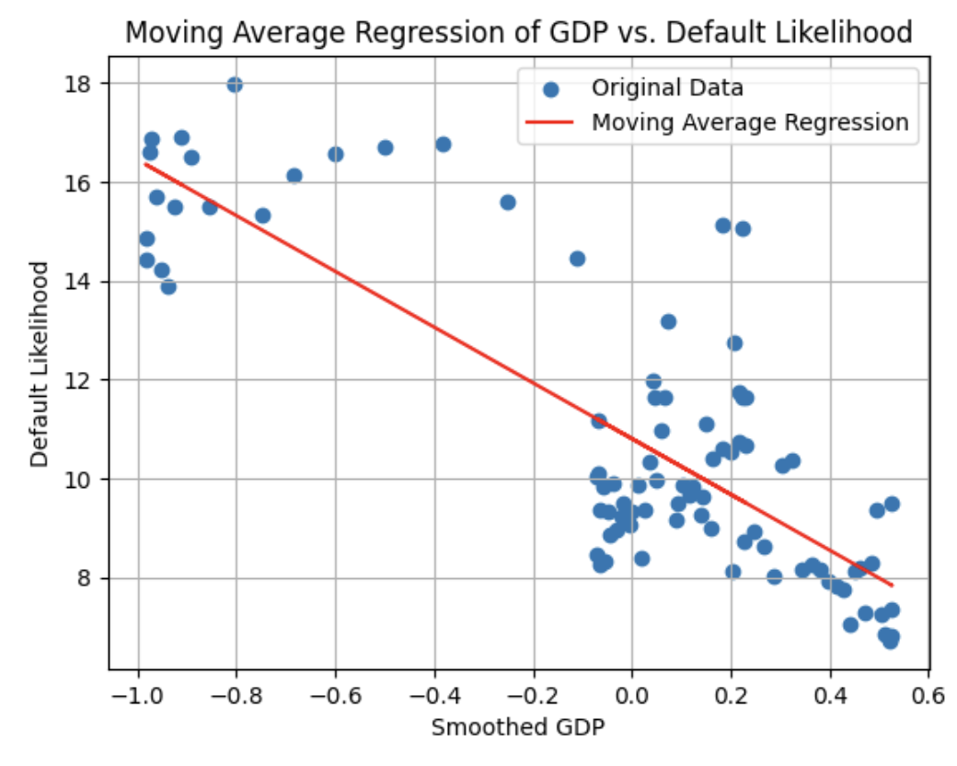
Part 2: Macroeconomic Correlation Analysis
2.2 Univariate Correlation: Analysis
2.2.1 Overall Economic Health: Chilean GDP
Graph Overview:
Blue dots represent the original data points of default likelihood against smoothed GDP values.
The red line illustrates the moving average regression, showing a clear negative trend between GDP and default likelihood.
Key Observations: Understanding Data Variability
Scatter of Data Points: Not uniformly distributed; varies widely at higher GDP levels, indicating influences beyond GDP alone (e.g., fiscal policy changes, economic shocks).
Density of Points: Denser in some areas, suggesting consistent default likelihood or more data availability. Sparse Areas indicate less data or stability in the relationship, complicating precise predictions.
Implications for Economic Analysis:
Risk Assessment & Planning: High variability around the regression line indicates the need for additional indicators in economic models for more accurate forecasting and risk management.Relying solely on GDP for predicting default likelihood is insufficient; incorporating a broader range of economic indicators enhances understanding and planning.

Slide 13
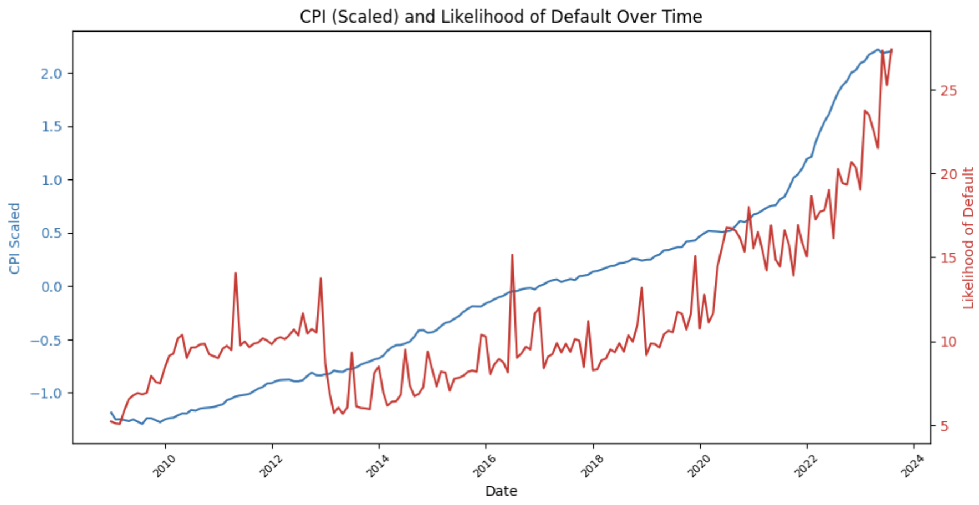
Part 2: Macroeconomic Correlation Analysis
2.2 Univariate Correlation: Analysis
2.2.2 Inflation: Chilean CPI
Graph Overview:
Blue Line: Represents the scaled Consumer Price Index (CPI) in Chile, showing general price level changes over time.
Red Line: Depicts the default rate, demonstrating how default rates have changed over the same period.
Default Rate: defined as the proportion of loans that are unpaid or written off, calculated monthly based on their issuance dates.
Key Observations:
CPI Growth:
Steady increase from 2010, with a sharp acceleration post-2020, indicating significant inflationary pressures in recent years.
Default Rate Trends:
Low and relatively stable default rates during the initial years, with a rise beginning around 2020, parallel to the spike in CPI.
Dramatically rises beginning around 2022, with trend continuing to-date.
Correlation:
The simultaneous sharp rise in both CPI and default rates post-2020 suggests a possible correlation where rising inflation may be impacting economic stability, increasing financial strain and default rates.
Economic Insight:
The steep increase in default likelihood coinciding with rising inflation could indicate that higher costs of living and operational costs may be financially straining entities responsible for highway maintenance or usage, leading to increased defaults.

Slide 14
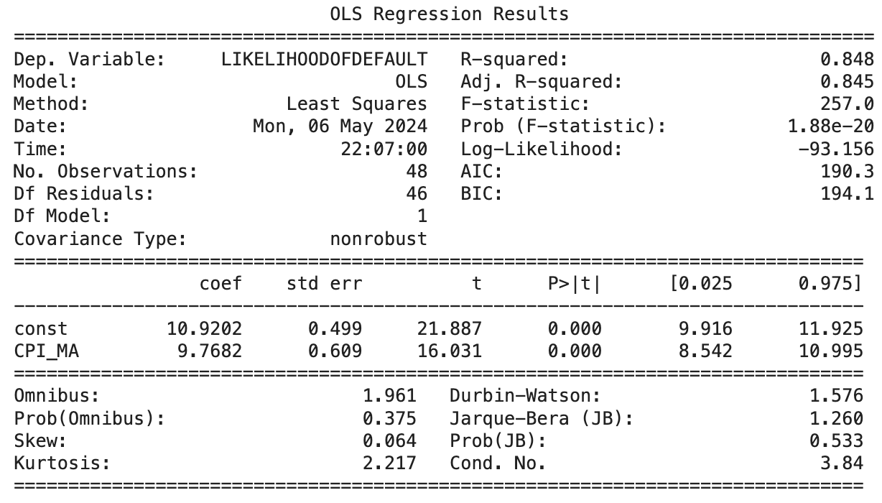
Part 2: Macroeconomic Correlation Analysis
2.2 Univariate Correlation: Analysis
2.2.2 Inflation: Chilean CPI
Regression Analysis with Moving Average
Independent Variable: Chilean CPI (Monthly)
Units: Index, Scaled
Granularity: Monthly
Window Size: 31
Dependent Variable: Default Rate
Units: % points
Granularity: Monthly
Summary of Results
Model Fit:
The regression model explains 84.8% of the variance in default likelihood (R-squared=0.848), demonstrating a strong model fit., with an adjusted R-squared of 0.845 confirming model robustness.
An F-statistic of 257.0, with a highly significant probability (Prob (F-statistic): 1.88e-20), indicates that the relationship between CPI and default rates is statistically significant and not due to chance.
Coefficients:
Constant (Intercept): 10.9202 (p < 0.000), suggesting a high baseline likelihood of default irrespective of CPI levels.
CPI Coefficient: 9.7682(p < 0.000), showing a strong positive impact of CPI on default likelihood; as CPI increases, the likelihood of default also significantly increases.
Implications:
The optimal window of 31 indicates a 2.5-year lagged effect of CPI on default rates. The significant positive relationship suggests that rising inflation is closely linked to elevated default risks.

Slide 15
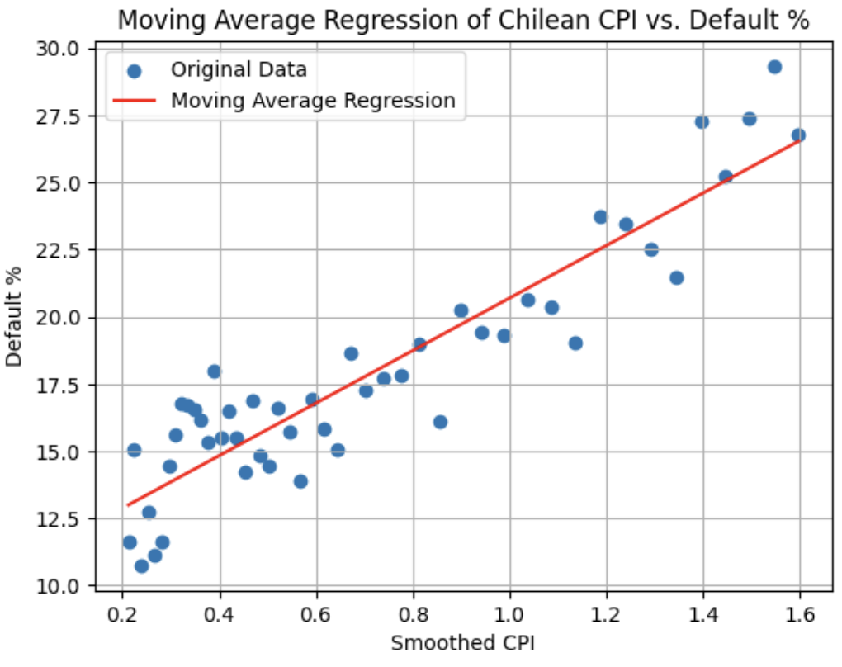
Part 2: Macroeconomic Correlation Analysis
2.2 Univariate Correlation: Analysis
2.2.2 Inflation: Chilean CPI
Graph Overview:
Blue dots represent the original data points of default rates plotted against smoothed values of CPI.
The red line shows the moving average regression line, displaying the relationship between CPI and default rates over time.
Key Observations
Close Correlation:
Data points closely align with the regression line, indicating a strong positive correlation between CPI and default rates.
Suggests that changes in CPI are closely mirrored by changes in default rates.
Consistent Spread:
Spread of default rates around the regression line is relatively narrow at most CPI levels
Implies that CPI is a consistent and significant predictor of default rates.
Regression Line Precision:
Precision of the regression line is notable particularly at moderate CPI levels, capturing the relationship with high accuracy.
However, as CPI increases, precision of the regression line diminishes slightly.
Suggests that while CPI remains a significant predictor of defaults, its predictive power may be less robust under conditions of high inflation, where other indicators may have more influence.
Notes:
Constant: not meaningful -

Slide 16
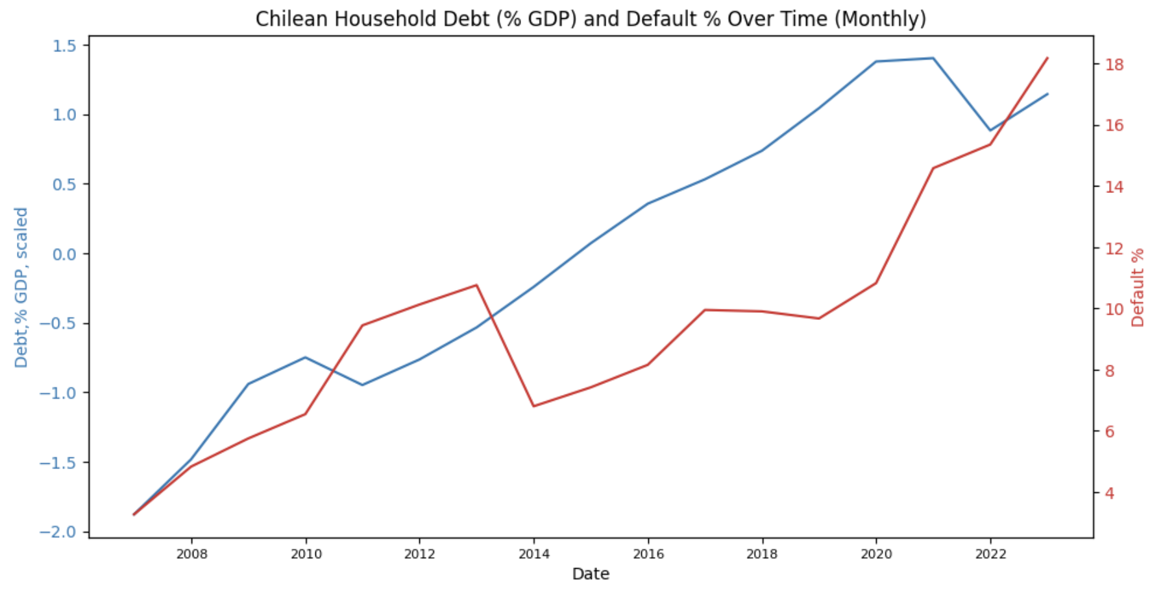
Part 2: Macroeconomic Correlation Analysis
Key Observations:
Correlation Between Debt and Default:
As household debt relative to GDP increases, so do default rates, suggesting a direct relationship where higher debt levels may be driving defaults.
Divergent Movements
2008-2012 Period: Decreasing Debt, Stable Defaults:
This period perhaps reflects a post-crisis adjustment where households are deleveraging, yet defaults do not increase, possibly due to stabilizing economic policies or relief measures.
2012-2016 Period:Increasing Debt, Stable Defaults:
As household debt begins to increase after 2012, default rates initially remain stable. Could indicate that the increasing debt had not yet reached a critical threshold affecting default rates, or that credit was still sustainably managed.
Post-2018 Period:Rapidly Increasing Debt, Sharp Increase in Defaults:
Although this period shows both metrics rising, the acceleration rates differ. Debt increases at a faster pace initially before defaults begin to sharply increase. The lag suggests that households initially coped with higher debt levels before financial pressures led to increased defaults.
2.2 Univariate Correlation: Analysis
2.2.3 Household Conditions: Household Debt
Graph Overview:
Blue Line: Tracks household debt as a percentage of GDP, highlighting changes in household financial burden.
Red Line: Represents highway default rates, illustrating fluctuations in financial obligations.

Slide 17
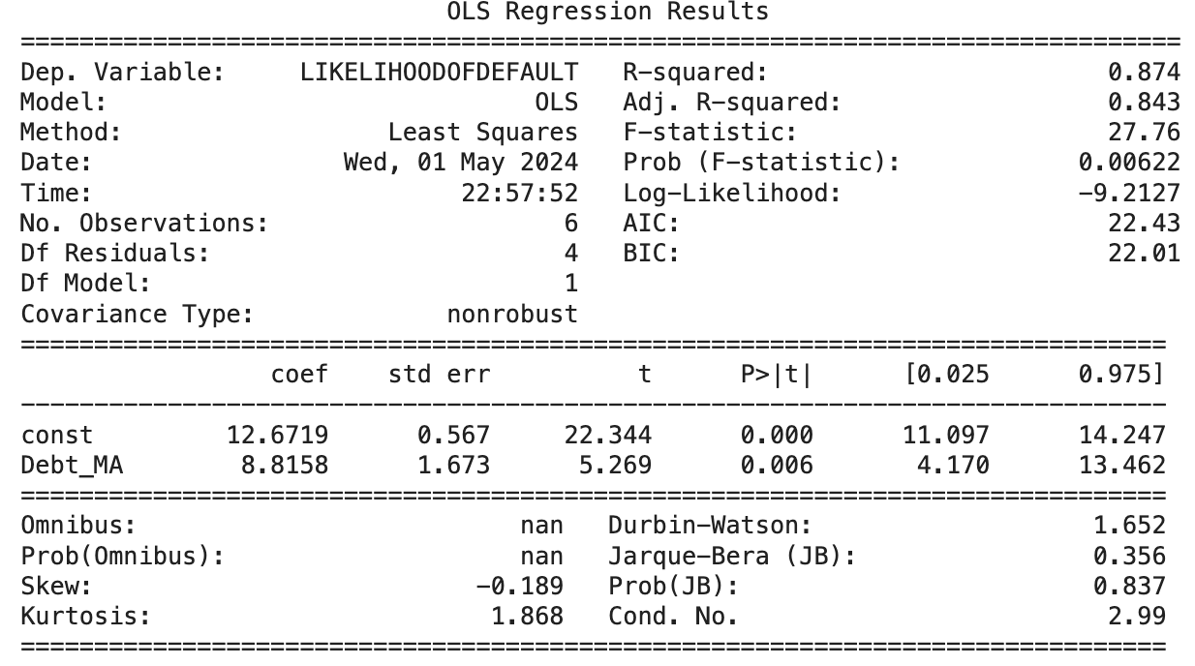
Part 2: Macroeconomic Correlation Analysis
2.2 Univariate Correlation: Analysis
2.2.3 Household Conditions: Household Debt
Regression Analysis with Moving Average
Independent Variable: Chilean Household Debt, Loans & Debt Securities
Units: % of GDP, Scaled
Granularity: Yearly
Window Size: 12
Dependent Variable: Default Rate
Units: % points
Granularity: Yearly
Summary of Results
Model Fit:
The regression model explains 87.4% of the variance in default likelihood (R-squared=0.847),demonstrating a very strong model fit.
An F-statistic of 27.76 with a highly significant (Prob (F-statistic): 0.00622), indicates the relationship between household debt and default rates is statistically significant and not due to random chance.
Coefficients:
Constant (Intercept): 12.6719 (p < 0.000), suggesting a high baseline likelihood of default irrespective of household debt levels.
Debt Coefficient: 8.8158 (p = 0.006), showing a strong positive impact of household debt on default likelihood; as debt increases, the likelihood of default also significantly increases.
Implications:
The large optimal window and significant positive relationship between household debt and default likelihood suggests that rising household debt levels are closely linked to increased highway defaults, with a prolonged lagged effect.

Slide 18
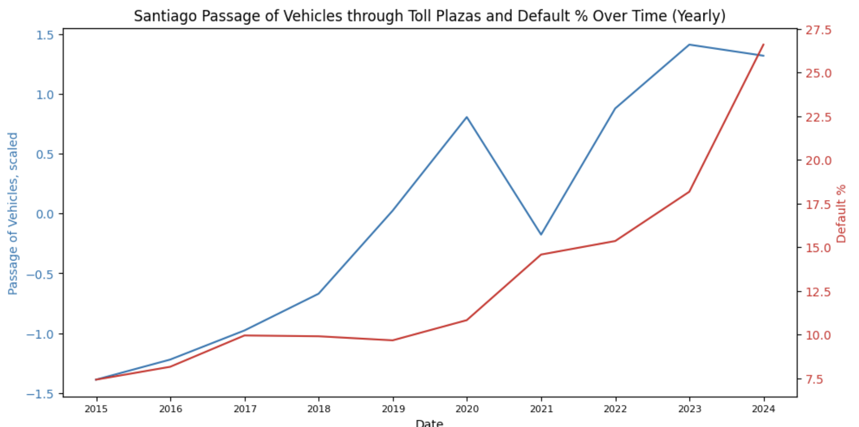
Part 2: Macroeconomic Correlation Analysis
2.2 Univariate Correlation: Analysis
Key Observations:
Traffic Volume Trends:
Notable increase from 2015 to 2019, a sharp decline in 2020 likely due to pandemic restrictions, followed by a recovery and growth in 2021 through 2023.
Default Rate Trends:
Steady rise from 2015 onwards, with an acceleration in the increase rate from 2020 despite recovery in traffic volumes, suggesting ongoing financial or systemic challenges in toll collection.
Correlation Insights:
Before 2020, traffic volumes and default rates showed a somewhat parallel trend, indicating consistent payment behavior relative to traffic. However, post-2020, the default rates continued to rise sharply, even as traffic volumes recovered, pointing to a disconnect between vehicle traffic and financial compliance.
Economic Implications:
The disconnect between rising vehicle traffic and increasing default rates post-2020 suggests that economic recovery in terms of traffic has not translated into improved financial compliance among toll users, possibly due to lingering economic hardships or changes in accustomed payment behavior.
2.2.4 Urban Transportation: Santiago Interurban Highway Passage
Graph Overview:
Blue Line: Represents the scaled number of vehicles passing through Santiago interurban highways over time.
Red Line: Depicts the percentage of default in highway toll collections during the same period.

Slide 19
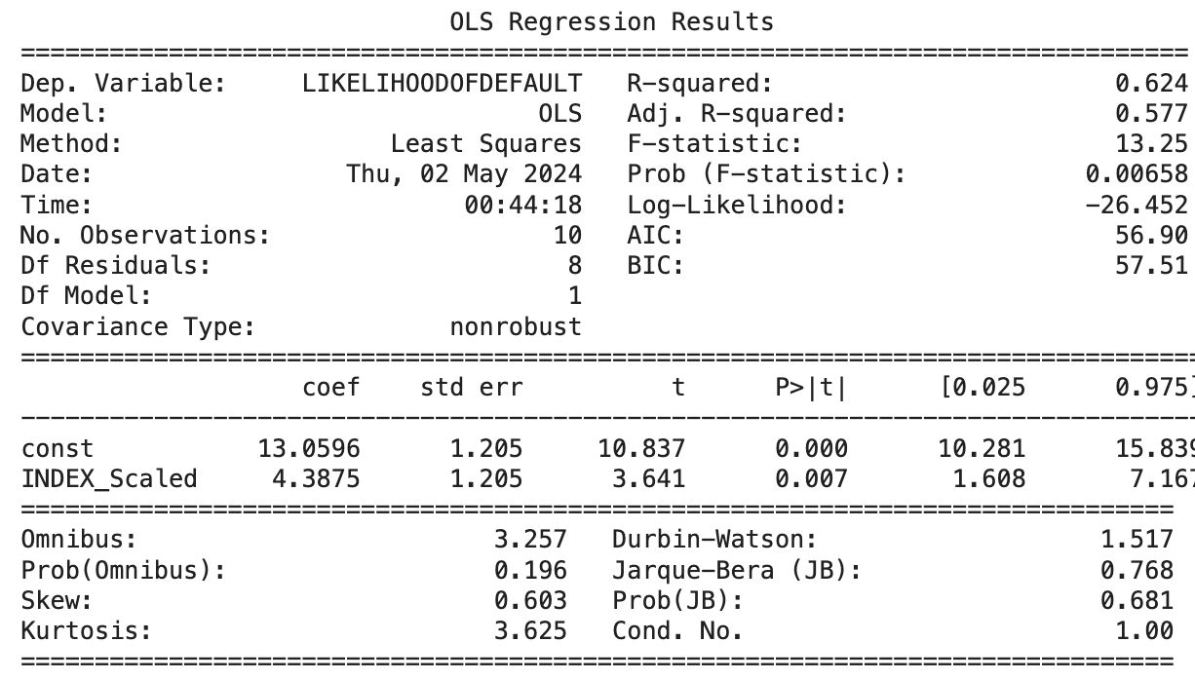
Part 2: Macroeconomic Correlation Analysis
2.2 Univariate Correlation: Analysis
2.2.4 Urban Transportation: Santiago Interurban Highway Passage
Regression Analysis
Independent Variable: Santiago Interurban Highway Passage
Units: Absolute Number, Scaled
Granularity: Yearly
Dependent Variable: Default Rate
Units: % points
Granularity: Yearly
Summary of Results
Model Fit:
The regression model explains 62.4% of the variance in default likelihood (R-squared=0.627),demonstrating a strong model fit.
An F-statistic of 13,25 with a highly significant (Prob (F-statistic): 0.00658), indicates the relationship between Santiago interurban traffic volume and default rates is statistically significant and not due to random chance.
Coefficients:
Constant (Intercept): 13.0596 (p < 0.000), indicating a high baseline likelihood of default irrespective of traffic volume levels.
Traffic Coefficient (INDEX_Scaled): 4.3875 (p = 0.007), showing a significant positive impact of traffic volume on default likelihood; as traffic increases, the likelihood of default also significantly increases.
Implications:
The significant positive relationship between increased traffic volumes and higher default rates suggests that rising traffic levels on interurban highways are closely linked to increased defaults.

Slide 20
Part 2: Macroeconomic Correlation Analysis
2.3 Multivariate Correlation
2.3.1 Approach
Objective: Identify a model with multiple indicators that collectively explains the effect of macroeconomics on default rates
Approach: Conduct a series of multivariate Ordinary Least Squares (OLS) regression with selection of variables
Step 1 - Variable Observation and Processing
Goal:
Inspect quality and readiness of data for multivariate regression
Determine method and analysis roadmap
Step 2 - Feature Selection and Regression
By No. of Observations
Monthly
Yearly
By Correlation
By Categories and Univariate Performance
With moving averages
Without moving averages
Step 3 - Model Compare and Contrast
Criteria:
Model Fit (adjusted R-squared, F-stats)
Diagnostic Tests (Durbin-Watson, Jarque-Bera, Cond. No)
Step 4 - General Conclusion and Explanations

Slide 21
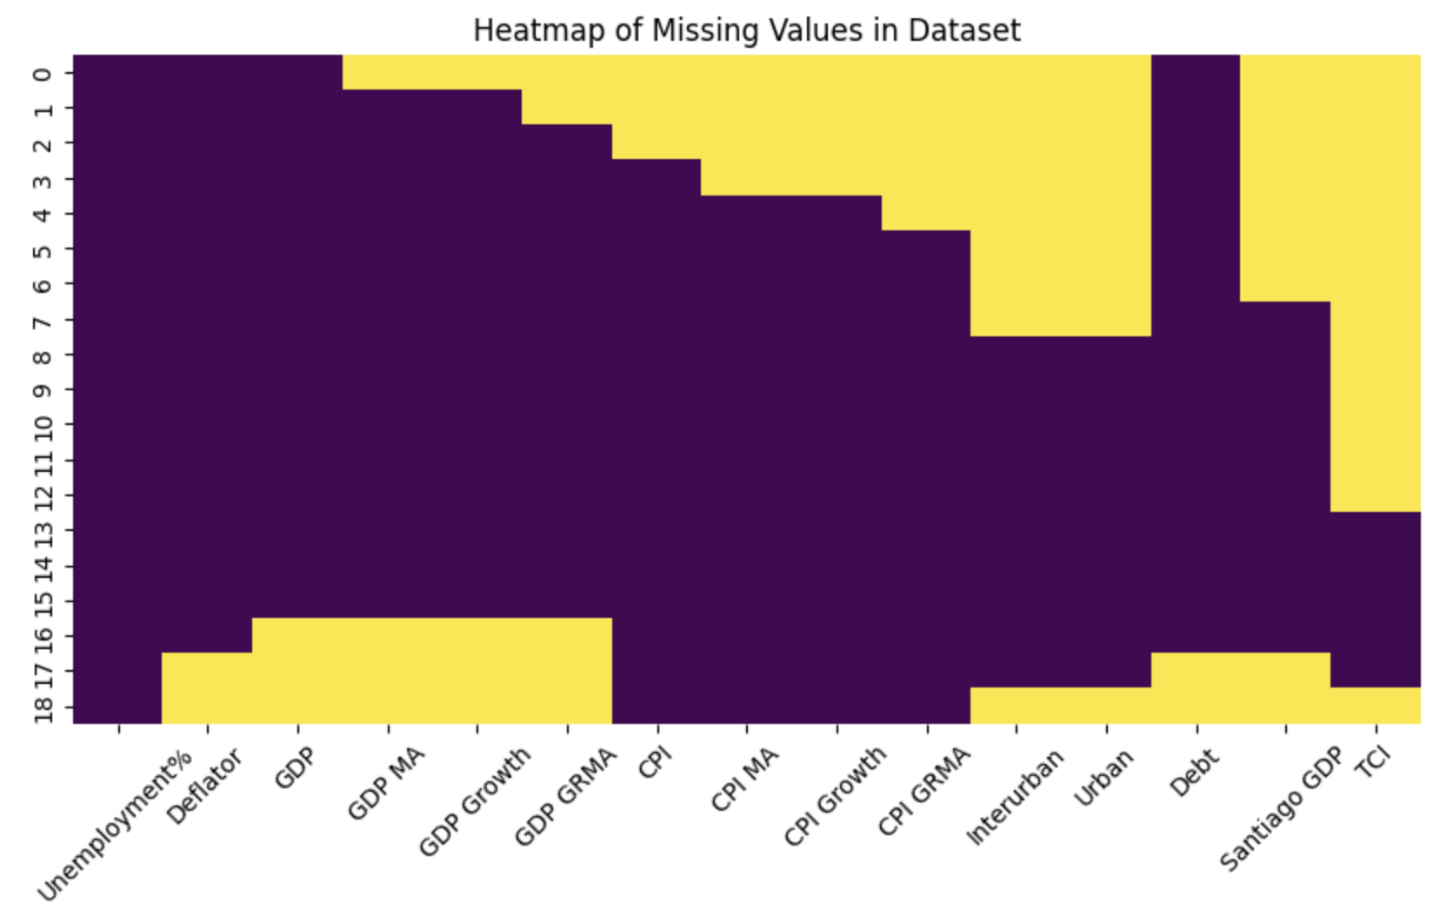
Part 2: Macroeconomic Correlation Analysis
2.3 Multivariate Correlation
2.3.2 Variable Observation and Processing
Goal:
Same Granularity
Linearity, homoscedasticity, independence of errors, normality, independence of independent variables
Number of observations: at least 10 observations per variable
Limitation:
Different Scales: monthly vs. yearly
Multicollinearity due to the nature of selected and calculated macroeconomic indicators
Limited number of observations:
Maximum 18 observations of default rates with yearly data (2006-2024)
15 variables
NaN values for each variable (yellow)
Window selection for moving averages:
Maximum 2
cannot reach durbin-watson optimization for yearly data - autocorrelation problem
Method:
Feature Selection
Backward Selection within selected features
Evaluate and Compare Multiple Models
Next Step: 3 methods for feature selection

Slide 22
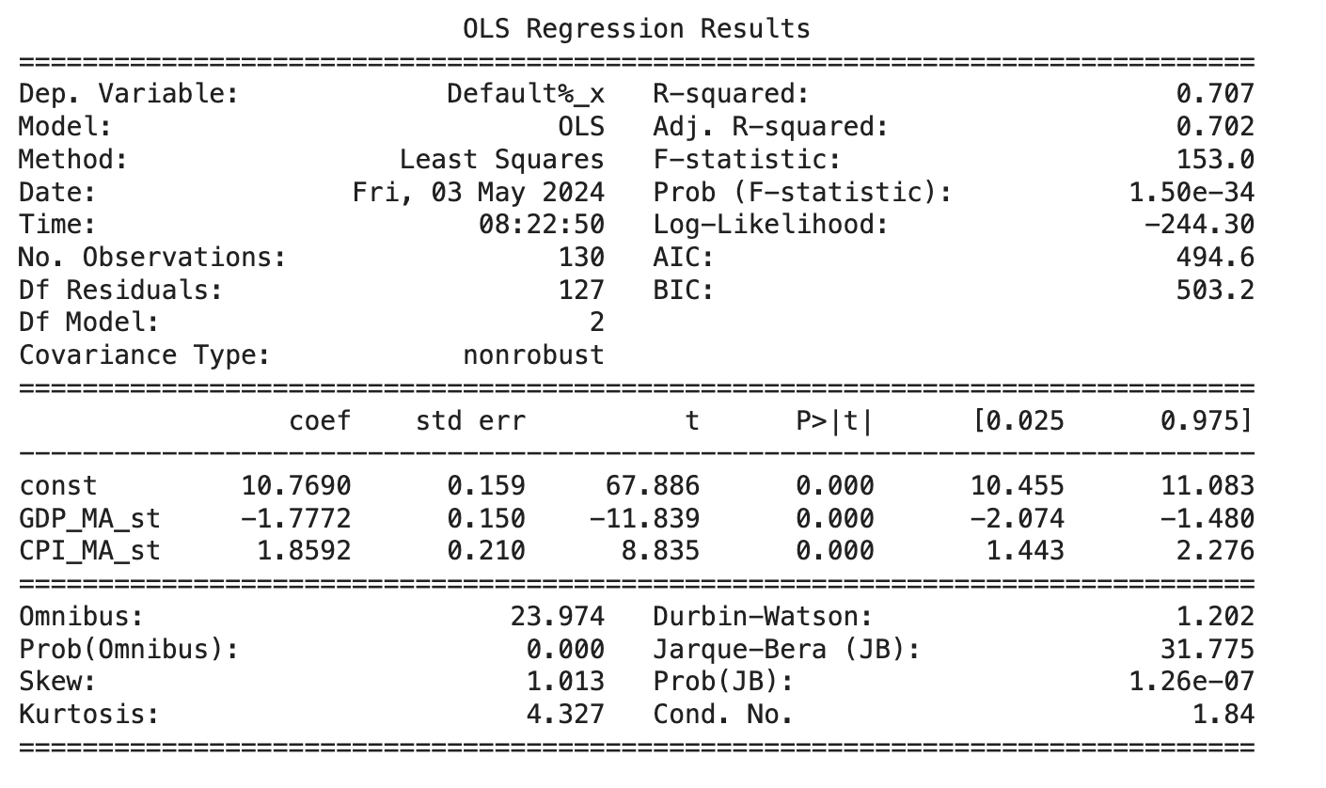
Part 2: Macroeconomic Correlation Analysis
2.3 Multivariate Correlation
2.3.3 Feature Selection and Regression
2.3.3.1 Method 1: by Number of Observation - Monthly
Goal: Maximize both number of observations and number of variables - monthly
Model:
Independent Variables:
Chilean GDP (Monthly), Moving Average
Window size: 33
Chilean CPI (Monthly), Moving Average
Window size: 26
Dependent Variable: Default Rate
Granularity: Monthly
Summary of Results
Model Fit:
The regression model explains 70.2% of the variance in default rate (adjusted R-squared=0.702),demonstrating a strong model fit.
An F-statistic of 153.0 with a low probability (Prob (F-statistic): 150e-34), indicates the model is statistically significant and not due to random chance.
Coefficients:
Constant (Intercept): 10.7690 (p < 0.000), indicating a high baseline default rate
Chilean GDP Moving Average Coefficient: -1.7772 (p < 0.000), showing a negative impact of Chilean GDP moving average on default rate
General CPI Moving Average Coefficient: 1.8592 (p < 0.000), showing a positive impact of CPI moving average on default rates
Model Diagnostics:
Autocorrelation: Durbin-Watson of 1.202 suggests there might be some positive autocorrelation in the residuals
Normality: Jarque-Bera (JB) of 31.775 indicates that the residuals do not follow a normal distribution
Multicollinearity: condition number of 1.84, which is very low, indicating that multicollinearity is likely not a problem

Slide 23
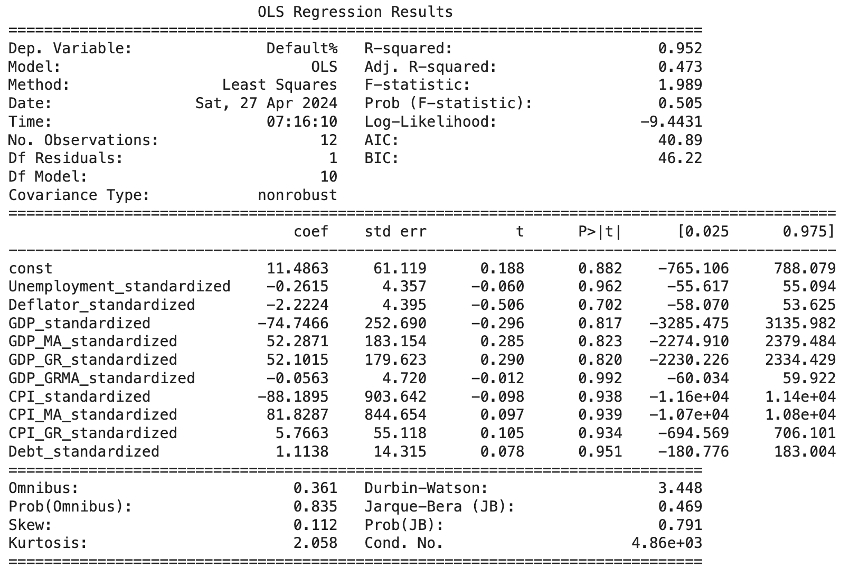
Part 2: Macroeconomic Correlation Analysis
2.3 Multivariate Correlation
2.3.3 Feature Selection and Regression
2.3.3.1 Method 1: by Number of Observation - Yearly
Goal: Maximize both number of observations and number of variables - yearly
Narrowing down by number of observation is not enough：
Multicollinearity

Slide 24
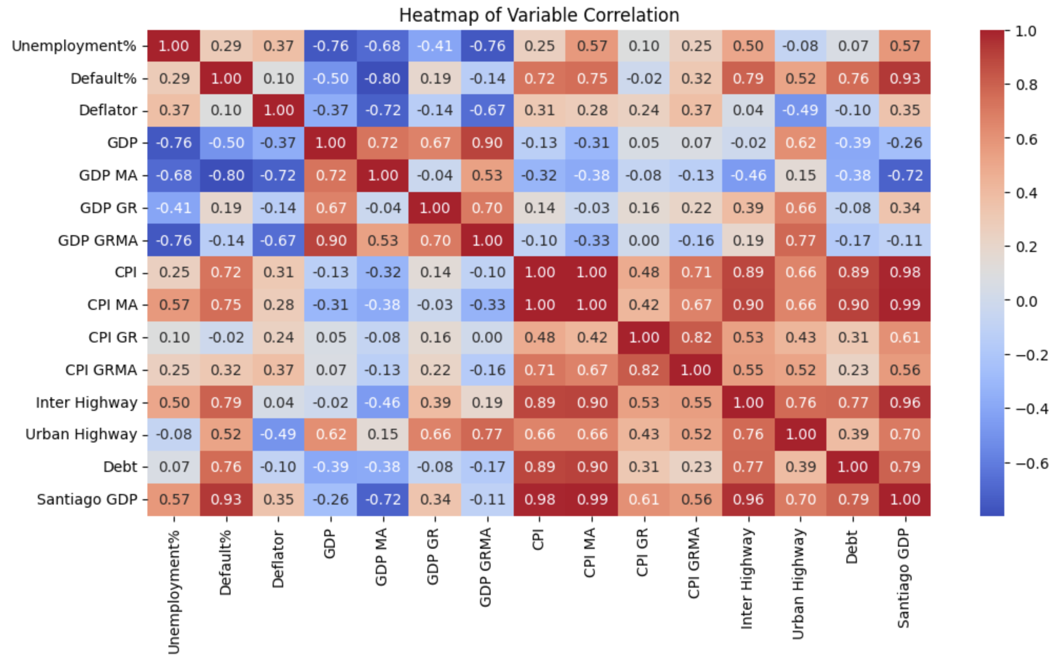
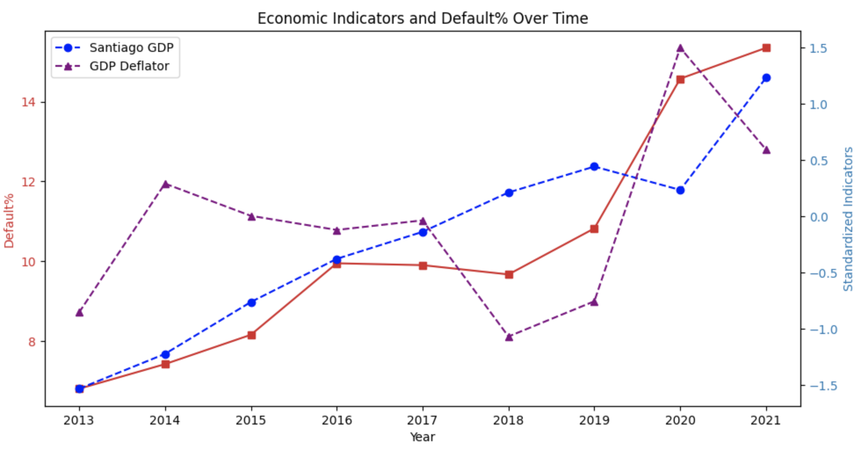
Part 2: Macroeconomic Correlation Analysis
Selection Process:
First Model: Santiago GDP, Chilean GDP Deflator, Chilean GDP
Chilean GDP p-value: 0.432
Final: Santiago GDP, Chilean GDP Deflator
2.3 Multivariate Correlation
2.3.3 Feature Selection and Regression
2.3.3.2 Method 2: by Correlation
Method:
Select variables are most closely related to default rates
Select variables are lease correlated with each other
Threshold: 0.5
Model:
Independent Variables:
Santiago GDP (million pesos), standardized
Chilean GDP Deflator, standardized
Dependent Variable: Default Rate (%)
Granularity: Yearly
Red: Default%
Blue: Santiago GDP (million pesos), standardized
Purple: Chile GDP Deflator, standardized

Slide 25
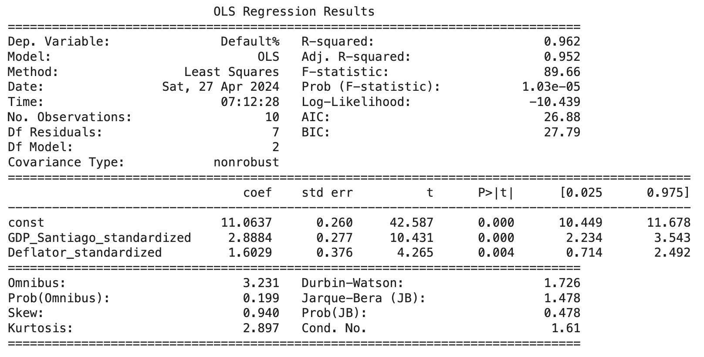
Part 2: Macroeconomic Correlation Analysis
2.3 Multivariate Correlation
2.3.3 Feature Selection and Regression
2.3.3.2 Method 2: by Correlation
Summary of Results
Model Fit:
The regression model explains 95.2% of the variance in default rate (adjusted R-squared=0.952),demonstrating a strong model fit.
An F-statistic of 89.66 with a low probability (Prob (F-statistic): 1.03e-05), indicates the model is statistically significant and not due to random chance.
Coefficients:
Constant (Intercept): 11.0637 (p < 0.000), indicating a high baseline default rate
Santiago GDP Coefficient: 2.8884 (p < 0.000), showing a significant positive impact of Santiago GDP on default rate
Deflator Coefficient: 1.6029 (p = 0.004), showing a positive impact of Deflator on default rates
Model Diagnostics:
Autocorrelation: Durbin-Watson of 1.726, which is close to 2, indicating a slight autocorrelation
Normality: Jarque-Bera (JB) of 1.478 indicates that the residuals are not significantly different from a normal distribution
Multicollinearity: condition number of 1.61, which is very low, indicating that multicollinearity is likely not a problem
Model:
Independent Variables (standardized):
Santiago GDP (in million pesos)
Chilean GDP Deflator (index)
Dependent Variable: Default Rate (%)
Granularity: Yearly
Notes:
Explanation: later in the conclusion part

Slide 26
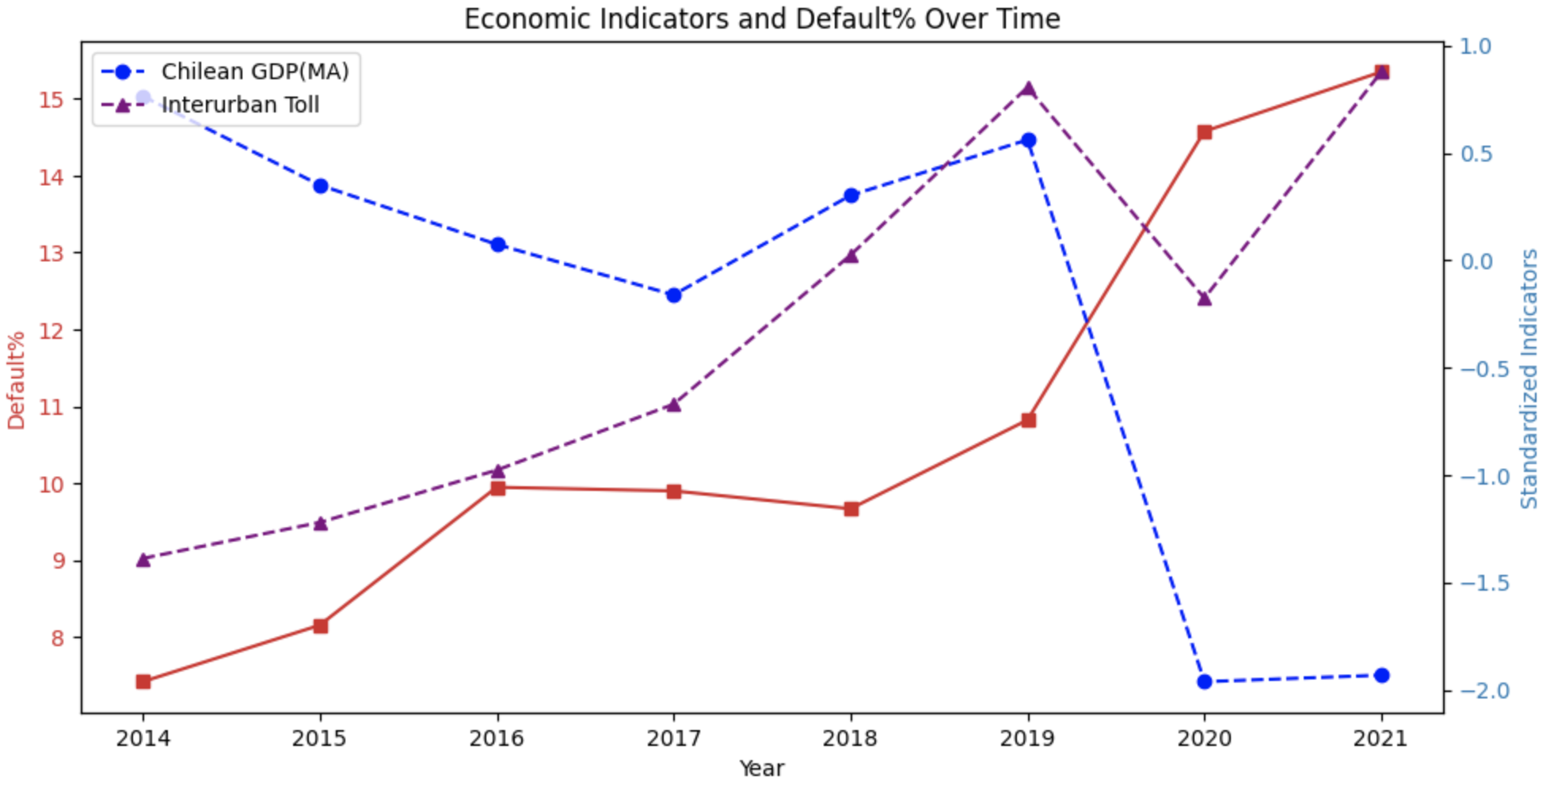
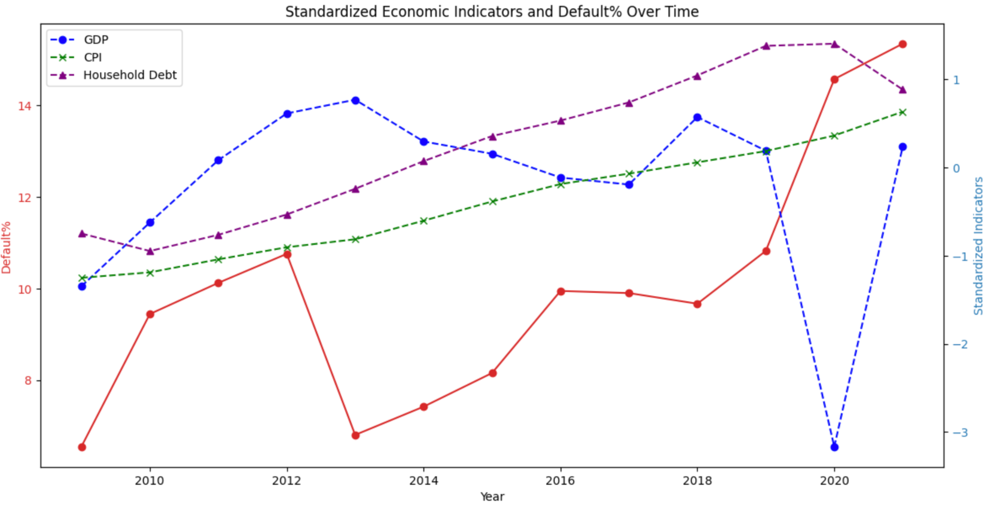
Part 2: Macroeconomic Correlation Analysis
2.3 Multivariate Correlation
2.3.3 Feature Selection and Regression
2.3.3.3 Method 3: by Univariate Performance
Regression Variable Selections with Moving Average:
Overall Macroeconomic Health: Chilean GDP, Moving Average
Inflation: Chilean CPI, Moving Average
Household Conditions: Household debt, loans, and debt securities (%GDP)
Urban Transportation: Santiago Passage of vehicles through Toll Plazas (Unit)
Regression Variable Selections without Moving Average:
Overall Macroeconomic Health: Chilean GDP
Inflation: Chilean CPI
Household Conditions: Household debt, loans, and debt securities (%GDP)
Urban Transportation: Santiago Passage of vehicles through Toll Plazas (Unit)

Slide 27
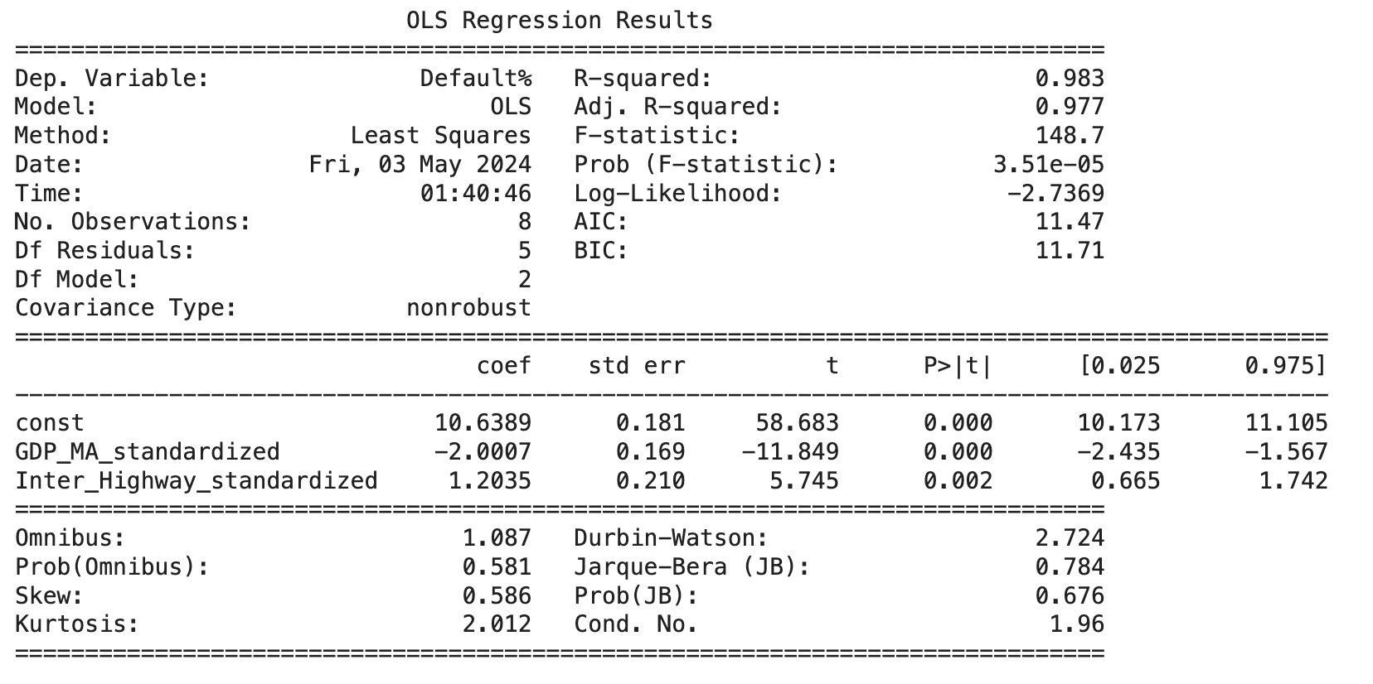
Part 2: Macroeconomic Correlation Analysis
2.3 Multivariate Correlation
2.3.3 Feature Selection and Regression
2.3.3.3 Method 3: by Univariate Performance
Model 1:
Independent Variables (standardized):
Chilean GDP, Moving Average
Santiago Passage of vehicles through Toll Plazas
Dependent Variable: Default Rate (%)
Granularity: Yearly
Summary of Results
Model Fit:
The regression model explains 97.7% of the variance in default rate (adjusted R-squared=0.977),demonstrating a strong model fit.
An F-statistic of 148.7 with a low probability (Prob (F-statistic): 3.51e-05), indicates the model is statistically significant and not due to random chance.
Coefficients:
Constant (Intercept): 10.6389 (p < 0.000), indicating a high baseline default rate
GDP Moving Average Coefficient: -2.0007 (p < 0.000), showing a significant negative impact of Chilean GDP moving average on default rate
Interurban Toll Coefficient: 1.2035 (p = 0.002), showing a significant positive impact of interurban traffic on default rate
Model Diagnostics:
Autocorrelation: Durbin-Watson of 2.724, indicating some degree of positive autocorrelation in the residuals
Normality: Jarque-Bera (JB) of 0.784 indicates that the residuals are not significantly different from a normal distribution
Multicollinearity: condition number of 1.96, which is very low, indicating that multicollinearity is likely not a problem

Slide 28
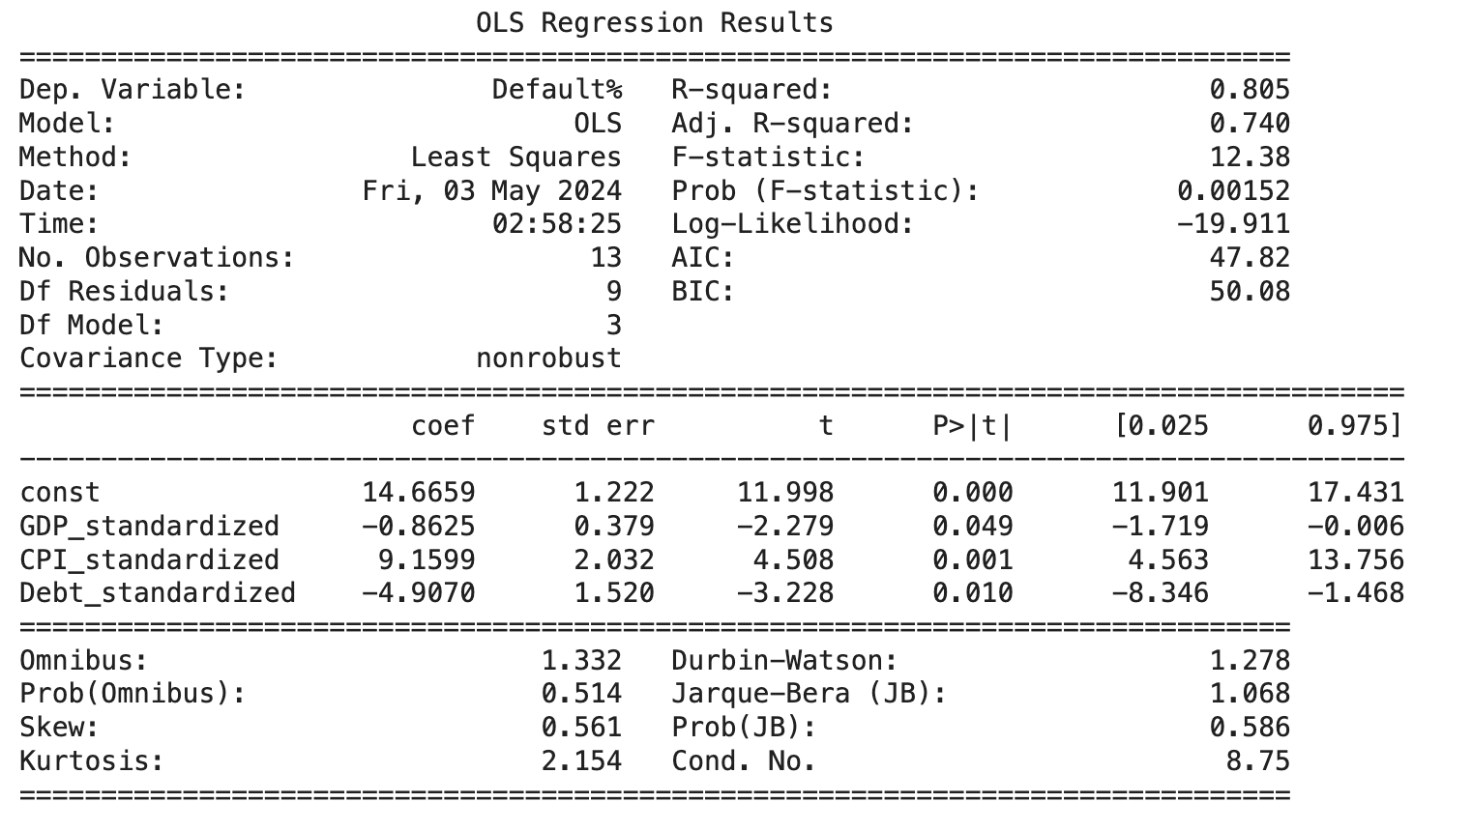
Part 2: Macroeconomic Correlation Analysis
2.3 Multivariate Correlation
2.3.2 Feature Selection and Regression
2.3.2.3 Method 3: by Univariate Performance
Model 2:
Independent Variables (standardized):
Chilean GDP
Chilean General CPI
Chilean Household Debt, Loans & Debt Securities
Dependent Variable: Default Rate (%)
Granularity: Yearly
Summary of Results
Model Fit:
The regression model explains 74.0% of the variance in default rate (adjusted R-squared=0.740),demonstrating a strong model fit.
An F-statistic of 12.38 with a low probability (Prob (F-statistic): 0.00152), indicates the model is statistically significant and not due to random chance.
Coefficients:
Constant (Intercept): 14.6659 (p < 0.000), indicating a high baseline default rate
GDP Coefficient: -0.8625 (p = 0.049), showing a negative impact of Chilean GDP on default rate
CPI Coefficient: 9.1599 (p = 0.001), showing a significant positive impact of CPI on default rate
Household Debt Coefficient: -4.9070 (p = 0.010), showing a significant negative impact of household debt on default rate
Model Diagnostics:
Autocorrelation: Durbin-Watson of 1.278, suggesting there may be some positive autocorrelation
Normality: Jarque-Bera (JB) of 1.068 indicates that the residuals are not significantly different from a normal distribution
Multicollinearity: condition number of 8.75, which is very low, indicating that multicollinearity is likely not a problem

Slide 29
Part 2: Macroeconomic Correlation Analysis
2.3 Multivariate Correlation
2.3.4 Model Compare and Contrast
Model | Model 1 | Model 2 | Model 3 | Model 4
Independent Variables | 1. Chilean GDP, Moving Average 2. Chilean General CPI, Moving Average | 1. Santiago GDP 2. Chilean GDP Deflator | 1. Chilean GDP, Moving Average 2. Santiago Interurban Toll Passage | 1. Chilean GDP 2. Chilean General CPI 3. Chilean Household Debt
Granularity | Monthly | Yearly | Yearly | Yearly
Coefficients | Const: 10.7690 (P>|t|=0.000) GDP MA: -1.7772 (P>|t|=0.000) CPI MA: 1.8592 (P>|t|=0.000) | Const: 11.0637 (P>|t|=0.000) Santiago GDP: 2.8884 (P>|t|=0.004) Deflator: 1.6029 (P>|t|=0.004) | Const: 10.6389 (P>|t|=0.000) GDP MA: -2.0007 (P>|t|=0.000) Interurban Toll: 1.2035 (P>|t|=0.002) | Const: 14.6659 (P>|t|=0.000) GDP: -0.8625 (P>|t|=0.049) CPI: 9.1599 (P>|t|=0.001) Debt: 4.9070 (P>|t|=0.010)
Model Fit | Adj. R-squared = 0.702 F-statistic = 153.0 | Adj. R-squared = 0.952 F-statistic = 89.66 | Adj. R-squared = 0.977 F-statistic = 148.7 | Adj. R-squared = 0.740 F-statistic = 12.38
Diagnostic Tests | Durbin-Watson = 1.202 Jarque-Bera = 31.775 Cond. No = 1.84 | Durbin-Watson = 1.726 Jarque-Bera = 1.478 Cond. No = 1.61 | Durbin-Watson = 2.724 Jarque-Bera = 0.784 Cond. No = 1.96 | Durbin-Watson = 1.278 Jarque-Bera = 1.068 Cond. No = 8.75
Model Comparison and Evaluation:
Model 1 analyzes monthly data and suggests that general CPI has a positive impact while GDP has a negative impact on the dependent variable. It has the lowest r-squared among the four and potential autocorrelation issues (Jarque-Bera).
For predictive accuracy and statistical reliability, Models 2 and 3 are preferable due to their high R-squared values, lower autocorrelation, and better conformity to normal distribution in residuals.
both feature a combination of national and regional indicators from Chile and Santiago for robust model fits
Model 2 captures economic fluctuations, while Model 3 combines the moving average of Chilean GDP with Santiago interurban toll rates, linking broader economic output with local transportation factors
Model 4 examines the impact of GDP, CPI, and household debt on a yearly basis, with a strong emphasis on CPI, but shows potential underfitting issues.

Slide 30
Part 2: Macroeconomic Correlation Analysis
2.3 Multivariate Correlation
2.3.5 General Conclusion and Explanations
Model | Model 1 | Model 2 | Model 3 | Model 4
Independent Variables | 1. Chilean GDP, Moving Average 2. Chilean General CPI, Moving Average | 1. Santiago GDP 2. Chilean GDP Deflator | 1. Chilean GDP, Moving Average 2. Santiago Interurban Toll Passage | 1. Chilean GDP 2. Chilean General CPI 3. Chilean Household Debt
Granularity | Monthly | Yearly | Yearly | Yearly
Coefficients | Const: 10.7690 (P>|t|=0.000) GDP MA: -1.7772 (P>|t|=0.000) CPI MA: 1.8592 (P>|t|=0.000) | Const: 11.0637 (P>|t|=0.000) Santiago GDP: 2.8884 (P>|t|=0.004) Deflator: 1.6029 (P>|t|=0.004) | Const: 10.6389 (P>|t|=0.000) GDP MA: -2.0007 (P>|t|=0.000) Interurban Toll: 1.2035 (P>|t|=0.002) | Const: 14.6659 (P>|t|=0.000) GDP: -0.8625 (P>|t|=0.049) CPI: 9.1599 (P>|t|=0.001) Debt: 4.9070 (P>|t|=0.010)
General Conclusion and Explanations:
Constants are all above 10, indicating a high baseline default rate regardless of macroeconomic indicators
Chilean GDP generally have a negative correlation with default rates, implying that economic growth generally correlates with a decreasing default rate
Deflator and general CPI generally have positive correlation with default rates, implying that higher inflation correlates to an increase in defaults
The difference between Santiago GDP and Chilean GDP might be due to the differences between national and city level conditions:
Santiago is the fastest growing economy in Chile. The economic growth in Santiago might not uniformly translate to financial stability for all its residents, particularly in the lower income brackets
Different policy and infrastructure investment, regional economic focus, economic stability, consumer spending behaviors etc.
Consider a combination of national and regional indicators from Chile and Santiago for robust model fits
Generally smaller coefficients for multivariate models compared to univariate models:
Dilution effect
More nuanced and accurate representation

Slide 31
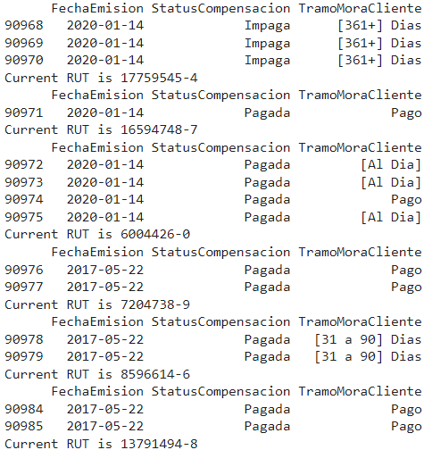
Part 3: Predictive Model: Data EDA
3.1 Vespucio Data EDA
3.1.1 Payment Behavior Consistency
Introduction
In many real life cases, we often see that people who used to pay for an item will continue paying for that item, and we think this may also be true in toll fee collection
Goal: To explore if there exists consistency payment behavior
Hypothesis: If an individual is willing to pay once, they are more likely to pay again, and if they failed to pay once, they may fail again; customers who have been using free-flow for longer time may have a higher possibility to be a consistent payer.
Initial Observation
As shown on the left, most of the customers indeed do show a strong consistency in their payment behavior. By taking the average of the percentile of consistent payment behavior for each RUT individuals, we collected an initial consistency of 97.94%, suggesting that for each individual, it is very likely that they will follow their previous payment behavior. In the later part, we used the customer’s first joined year and last payment year to identify the “CUSTOMER LIFESPAN”, and explored its relationship with the payment behavior.

Slide 32
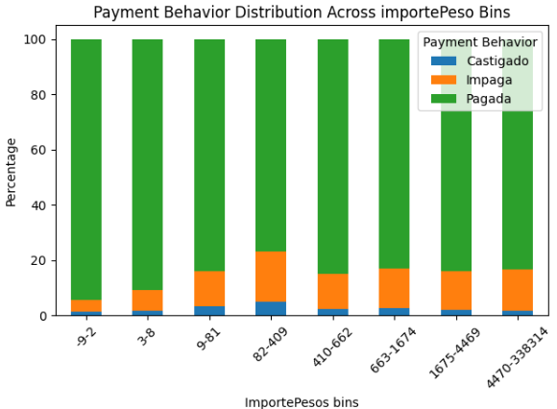
Part 3: Predictive Model: Data EDA
3.1 Vespucio Data EDA
3.1.2 Toll Fee Amount vs Payment Behavior
Introduction
Goal: To explore if different toll fee amount affects payment behavior
Hypothesis: The higher the fee, the more likely for people not willing to make payment, as it is too expensive
Initial Observation
We set the bins so as ensure that the number of samples in each bin is the same. To our surprise, the transaction amount doesn’t seem to significantly affect the collection rate, and in fact the lowest collection rate occur in the bin ranging from 9 to 81 pesos, and the bin ranging from 82 to 409 pesos.

Slide 33
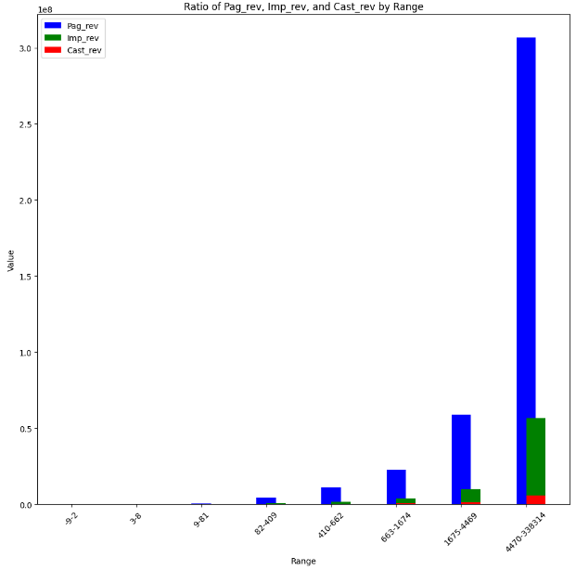
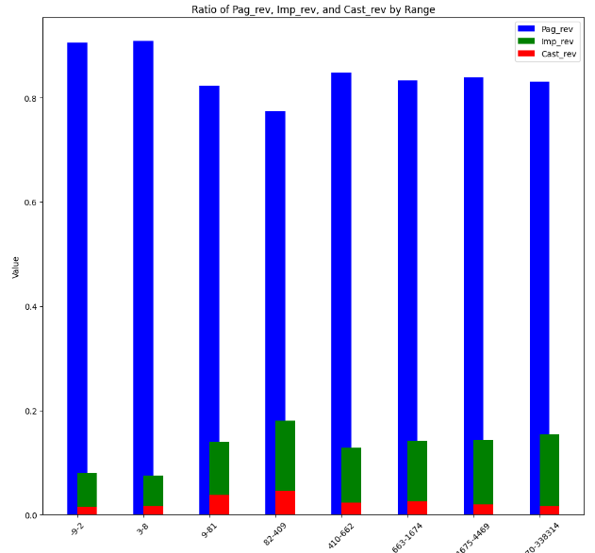
Part 3: Predictive Model: Data EDA
3.1 Vespucio Data EDA
3.1.2.2 Toll Fee Amount vs Payment Behavior, Deeper Dive & Possible Rationale
There may exist certain regulation methods adopted by Vespucio when the transaction amount is above 410 pesos, as that is when the revenue collected in that bin will start to account for a significant portion of the total revenue. And even with the intervention, we still observe that the collection rate as well as the realized revenue rate is dropping as the transaction amount is increasing. Thus, we consider to add another categorical variable which will be 0 when the ImportePesos is below 350, and 1 when it is above.

Slide 34
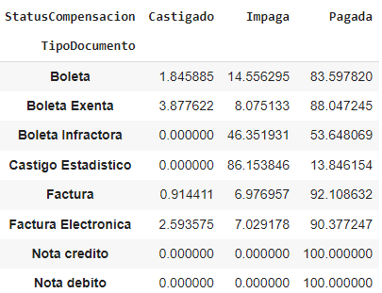
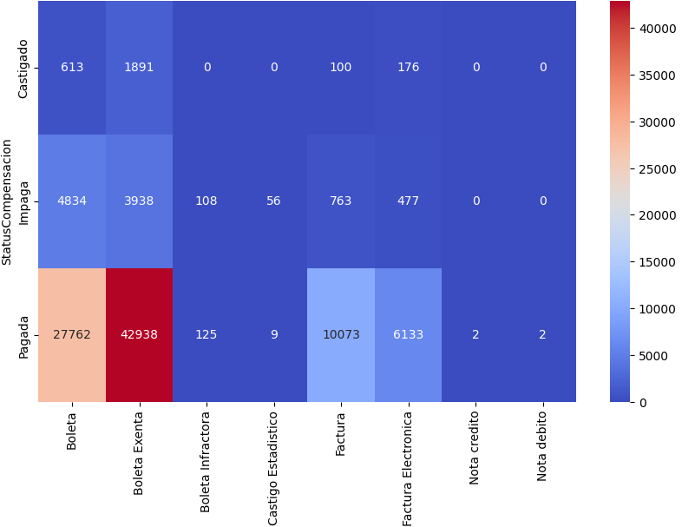
Part 3: Predictive Model: Data EDA
3.1 Vespucio Data EDA
3.1.3 Document Type vs Payment Behavior
Introduction
The dataset includes orders from different document types, and there can be in total over 20 types, yet here, we only have observed these following types of documents:’Boleta Exenta', 'Factura', 'Boleta', 'Factura Electronica', 'Boleta Infractora', 'Nota debito', 'Castigo Estadistico', and 'Nota credito'
Goal: To explore if the type of documents affects payment behavior
Hypothesis: There are certain documents which are registered directly to show that this order is a “bad” order, such as these documents registered as “cancelled” and “ receipt for evaders”, we will expect the collections rate for these orders to be significantly lower.
Initial Observation
As expected, the collection rate for Boleta Infractora (Evader Receipt) and Castigo Estadistico (Cancelled) is significantly lower than other types of documents. But to our surprise, the document type is not very diversified, but highly concentrated in Boleta and Boleta Exenta.

Slide 35
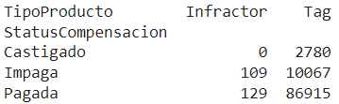
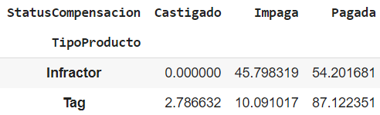
Part 3: Predictive Model: Data EDA
3.1 Vespucio Data EDA
3.1.4 Product Type vs Payment Behavior
Introduction
TipoProducto is a variable identifying if the transaction was generated by a small sensor or not. If it was not, then that user maybe either a infractor or a evader.
Goal: To explore how people from different TipoProducto will have payment behaviors
Hypothesis: These tagged drivers should behave better than infractor and evaders in making payment
Initial Observation
As expected, the collection rate for Tagged drivers is significantly higher than non-tagged drivers. But, it’s worth noticing that out of 100000 observations, only 238 are identified as non-tagged drivers.

Slide 36
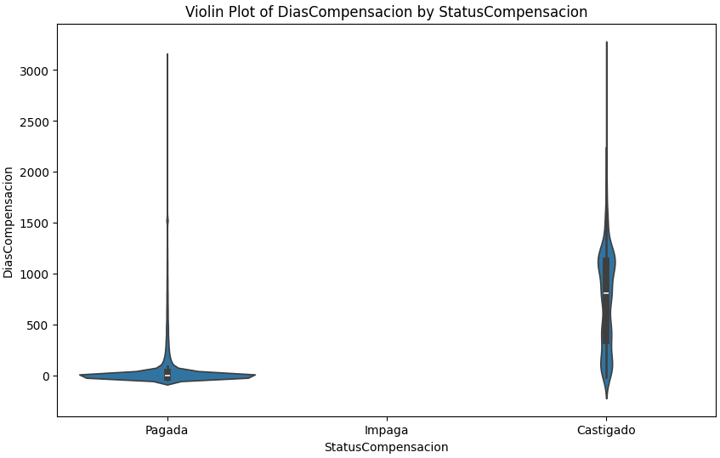
Part 3: Predictive Model: Data EDA
3.1 Vespucio Data EDA
3.1.5 Payment Delay vs Payment Behavior
Introduction
DiasCompensacion is a variable showing the delay in making payment, yet, for all these verified as not making payment, their DiasCompensacion will be tagged as Nan
Goal: To explore how delay in payment will affect payment behaviors
Hypothesis: People willing to make payment will be more likely to concentrate in a lower payment delay, and the longer the delay, the higher the possibility for not making payment
Initial Observation
From the violin plot, it is obvious that for people making payment, they are more concentrated between below 0 days to less than 100 days, while for Castigado, the customers are more evenly distributed between 0 to 1300 days, while the majority is above 500 days. The observation does coincide with our hypothesis.

Slide 37
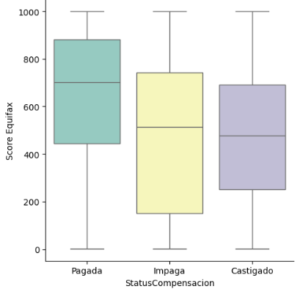
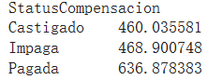
Part 3: Predictive Model: Data EDA
3.2 Equifax Data EDA
3.2.1 Equifax Score vs Payment Behavior
Introduction
Equifax operates as a credit reporting agency, offering credit information and risk management services to financial institutions, businesses, and consumers. The score is usually between 280 to 850.
Goal: To explore if a higher or lower score reflects different payment behaviors
Hypothesis: For individuals making payment, they should have a higher average score
Initial Observation
From the boxplot, we can tell that the Pagada group has an apparently higher median than other two groups, and the range is generally higher as well. Taking a closer look into the group mean, we noticed that the Pagada group has a significantly higher average Equifax score than the other two groups.

Slide 38
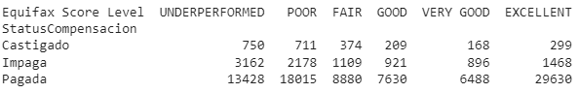
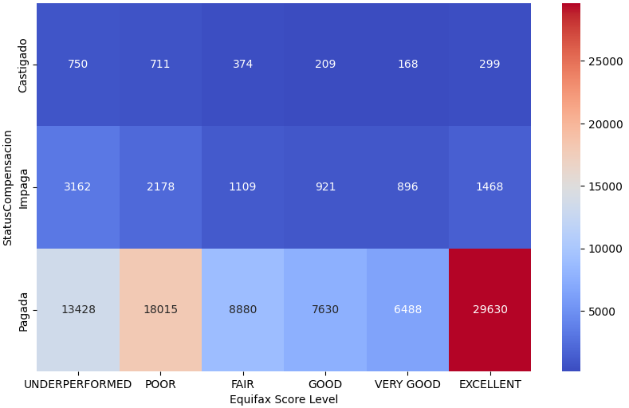
Part 3: Predictive Model: Data EDA
3.2 Equifax Data EDA
3.2.2 Equifax Levels vs Payment Behavior
Introduction
Equifax operates as a credit reporting agency, offering credit information and risk management services to financial institutions, businesses, and consumers. The score is usually between 280 to 850.
Goal: To explore if a higher or lower score reflects different payment behaviors
Hypothesis: For individuals making payment, they should have a higher average score
Initial Observation
From the boxplot, we can tell that the Pagada group has an apparently higher median than other two groups, and the range is generally higher as well. Taking a closer look into the group mean, we noticed that the Pagada group has a significantly higher average Equifax score than the other two groups.

Slide 39
Part 3: Predictive Model: Data EDA
Initial Test on Significance of Continuous Variables in 3.1 & 3.2
PREPARATION
Converted StatusCompensacion into default rate
Normalized each independent variable
Year range set between 2021-2023
METHOD
To avoid assumption on linearity, chose to use Spearman’s Rank Correlation
RESULTS
All showing significance, results as assumed in previous EDA

Slide 40
Part 4: Predictive Model
4.1 Building the Default Prediction Model
Joined Dataset: 482 M rows, 39 columns
Data Preprocessing & Feature Engineering
Join data on RUT (unique Chilean identifier) to get the equifax score (credit score) for each user
This joined data has been stored in Snowflake which is later being used for all analysis
Filter on invoices from 2021, 2022 and 2023
Filter transactions where TipoOperacion = ‘Peage’ i.e Tolls
Drop columns that are unique identifiers (10 columns were dropped). These columns include invoice ids, billing number, RUT etc.
Drop columns with over 70% missing values (2 columns were dropped)
Create three calculated features:
Month_invoiced
Day_of_the_week invoiced
Customer_lifespan (Last invoice year the customer is present with us in the system - First year customer joined)
Drop columns that have a very high correlation with one another (8 columns were dropped). These include having codes in words and numbers, 3 columns for region etc.
Scale numerical features (Standardization and Normalization)
One- Hot encode the categorical features
Data used for the model: 14 explanatory variables, 1 target variable, 102 M rows (sampled 1.02M rows)
Explanatory columns: ImportePesos (Transaction Amount), CantidadCuentasContrato (No. of contracts), CantidadVehiculos (No. of vehicles), Score Equifax (Credit score), Customer_lifespan,
Inhabilitado(Tag user), Concesionaria (Highway concession type),
TipoCliente (Type of client- Natural/Legal entity), TipoDocumento
(Type of Document), TipoProducto (Tag/Infractor), Day_of_week_invoiced, MaxCategoriaVehiculo(Vehicle Category),
CIUDAD (City)
Target column: Unpaid (1/0) (Unpaid and cancelled transactions have both been counted under Unpaid) Target class ratio (Unpaid : Paid) = 13%:87%
Perform a train-test split of 80% : 20%
Train and fit the classifier instance on 80% training data
Get the predicted probabilities of default and binary classification based on a threshold of 0.5
Four models were trained: Logistic Regression, XGBoost, Random Forest and LightGBM

Slide 41
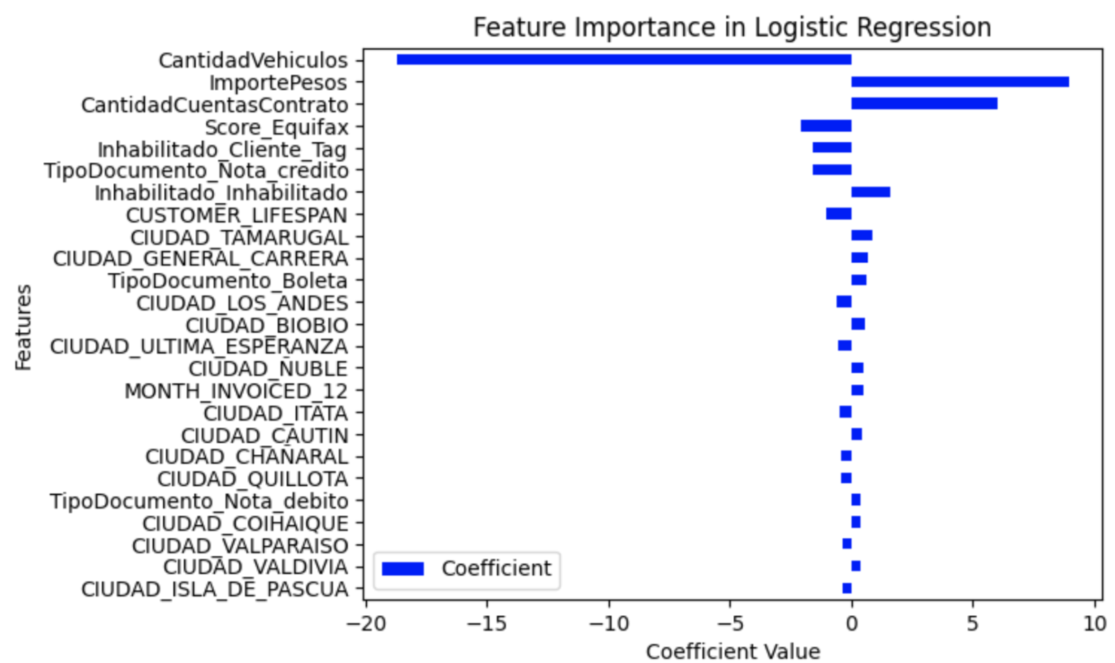
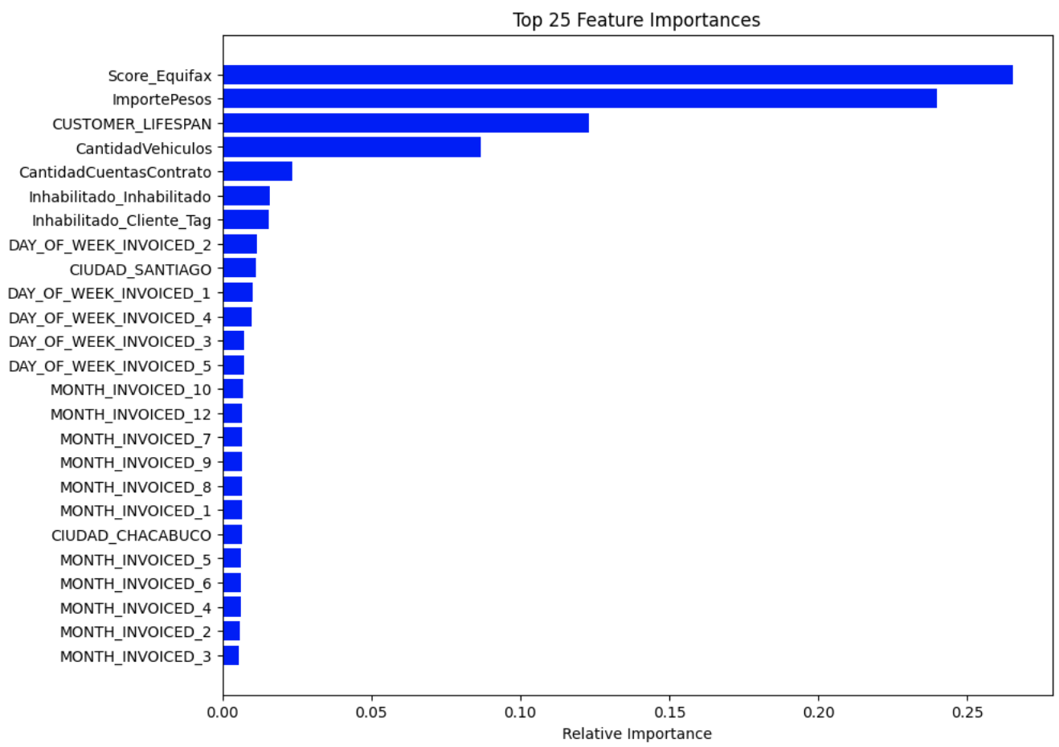
Part 4: Predictive Model
4.1.1 Logistic Regression & Random Forest
Logistic Regression
Accuracy: 88.5%
Precision: 72.1%
Recall:5%
F1 Score: 10%
Random Forest
Accuracy: 88.5%
Precision: 57%
Recall: 15.5%
F1 Score: 24.4%

Slide 42
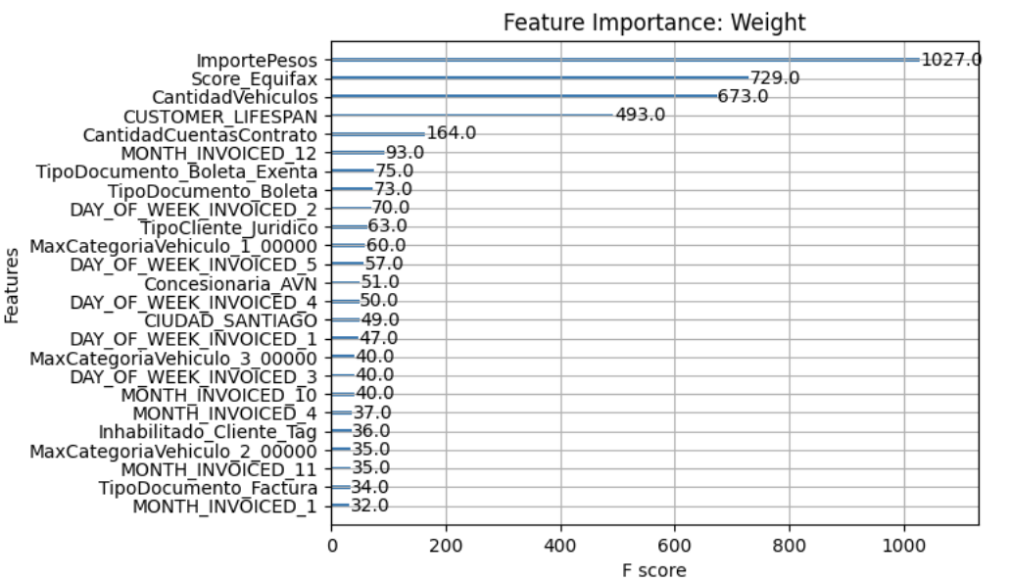
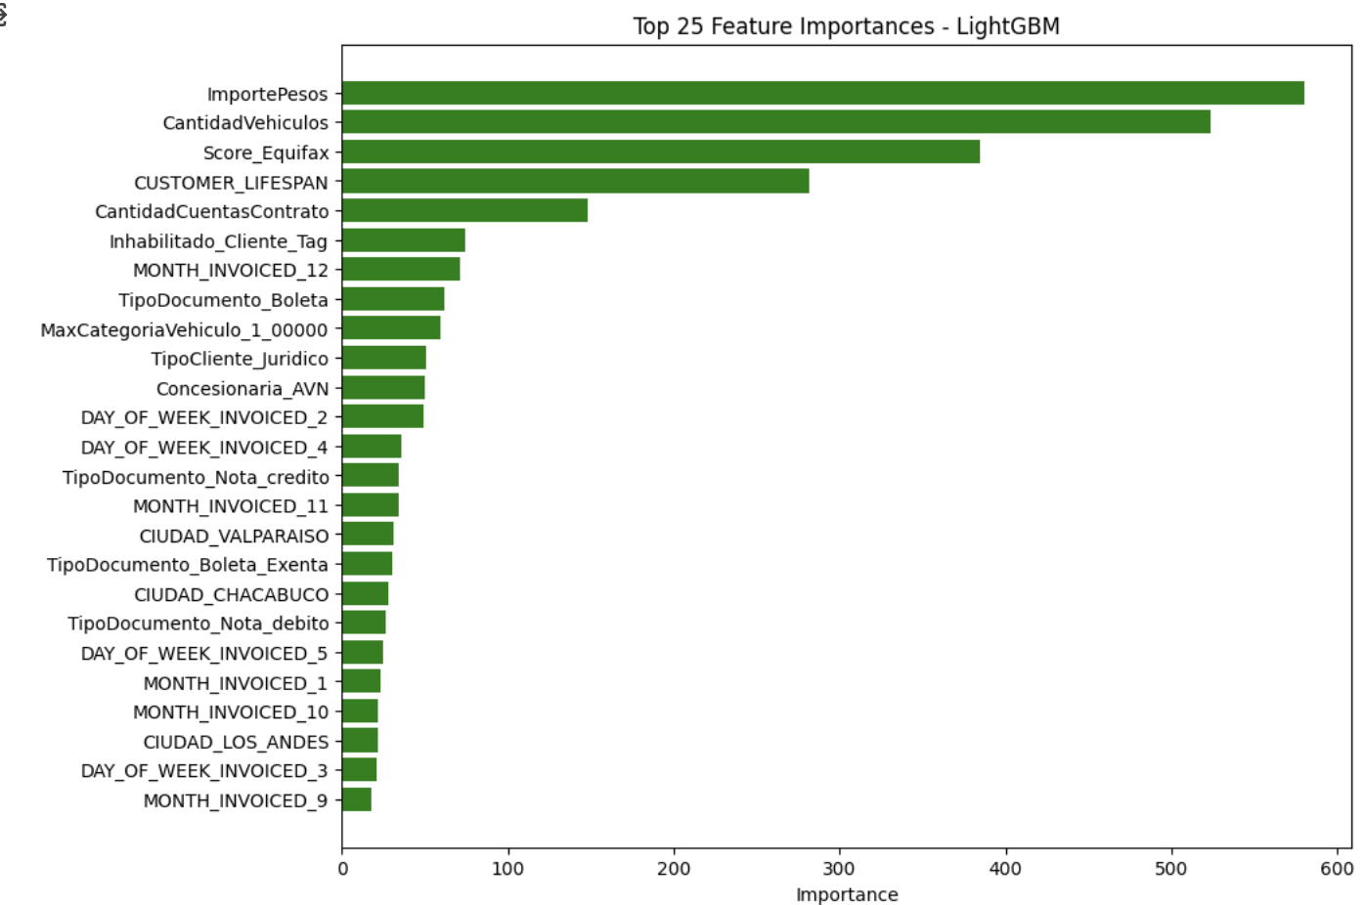
Part 4: Predictive Model
4.1.2 XGBoost & LightGBM
XGBoost
Accuracy: 89%
Precision: 70%
Recall: 14.6%
F1 Score: 24.2%
LightGBM
Accuracy: 88.9%
Precision: 72.9%
Recall: 11.59%
F1 Score: 20%

Slide 43
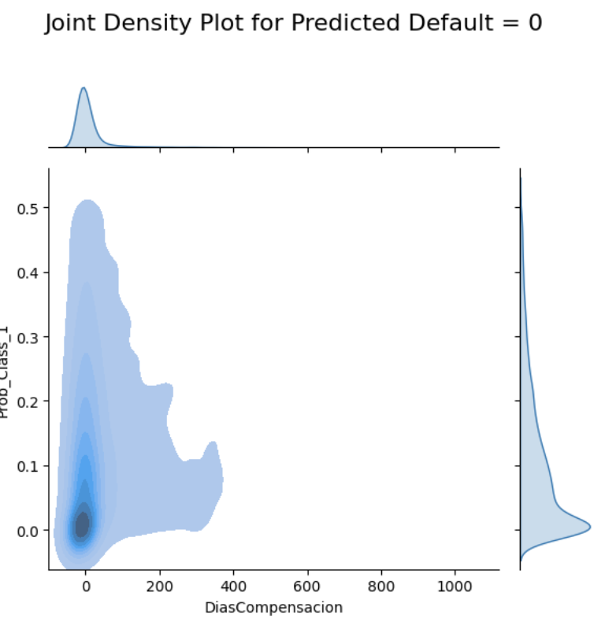
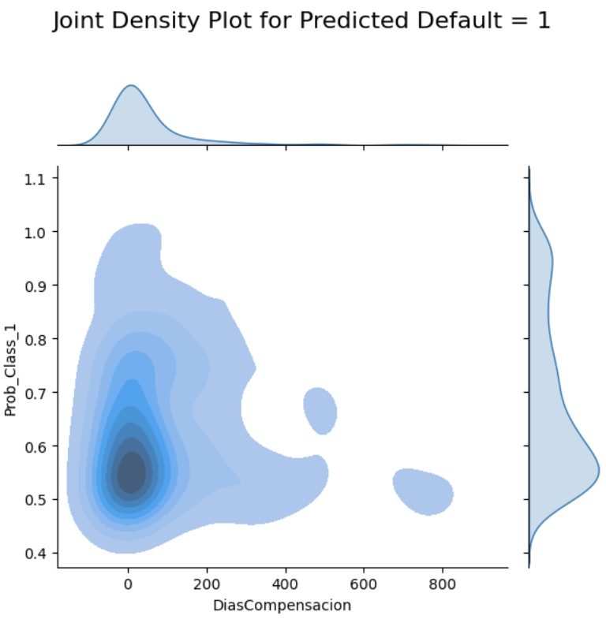
Part 4: Predictive Model
4.1.2 Diving into predictions
Key Observations and Hyperparameter Tuning
All tree-based algorithms exhibit very similar results in terms of performance
In addition to these 4 algorithms, we also explored CatBoost which is well-known to work well with more categorical data. CatBoost also exhibits a very similar performance
Based on the predicted probabilities for default and actual defaults we see the model is able to predict Paid transactions well
If the business demands higher recall i.e catch unpaid invoices more strictly (higher false positives are okay), the best threshold we get from AUC ROC curve is 0.12. This increases the recall to 80% and the precision goes down to around 27% with an f1-score of 42%
XGBoost and LightGBM were hyperparameter tuned to increase the estimators, depth while reducing the learning rate but the results hardly improve

Slide 44
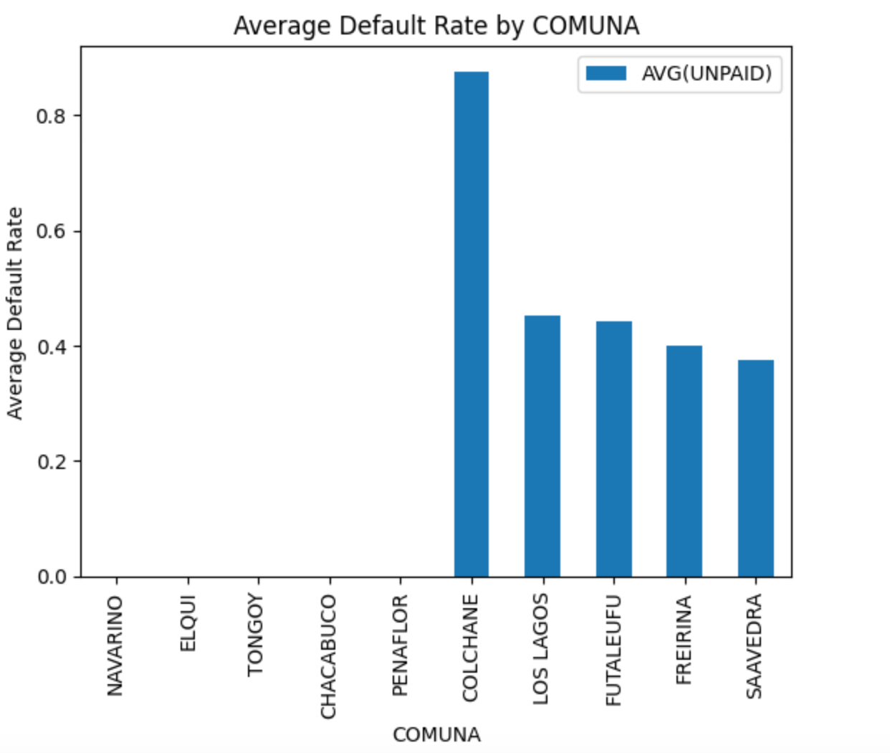
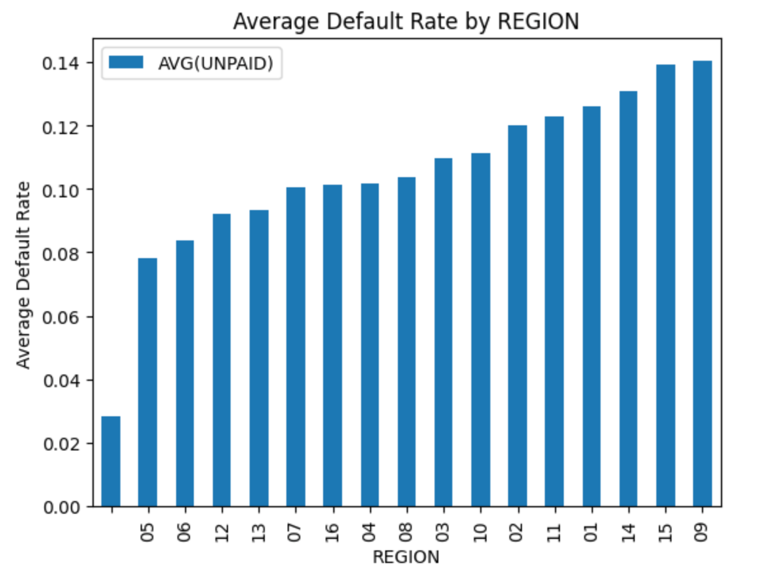
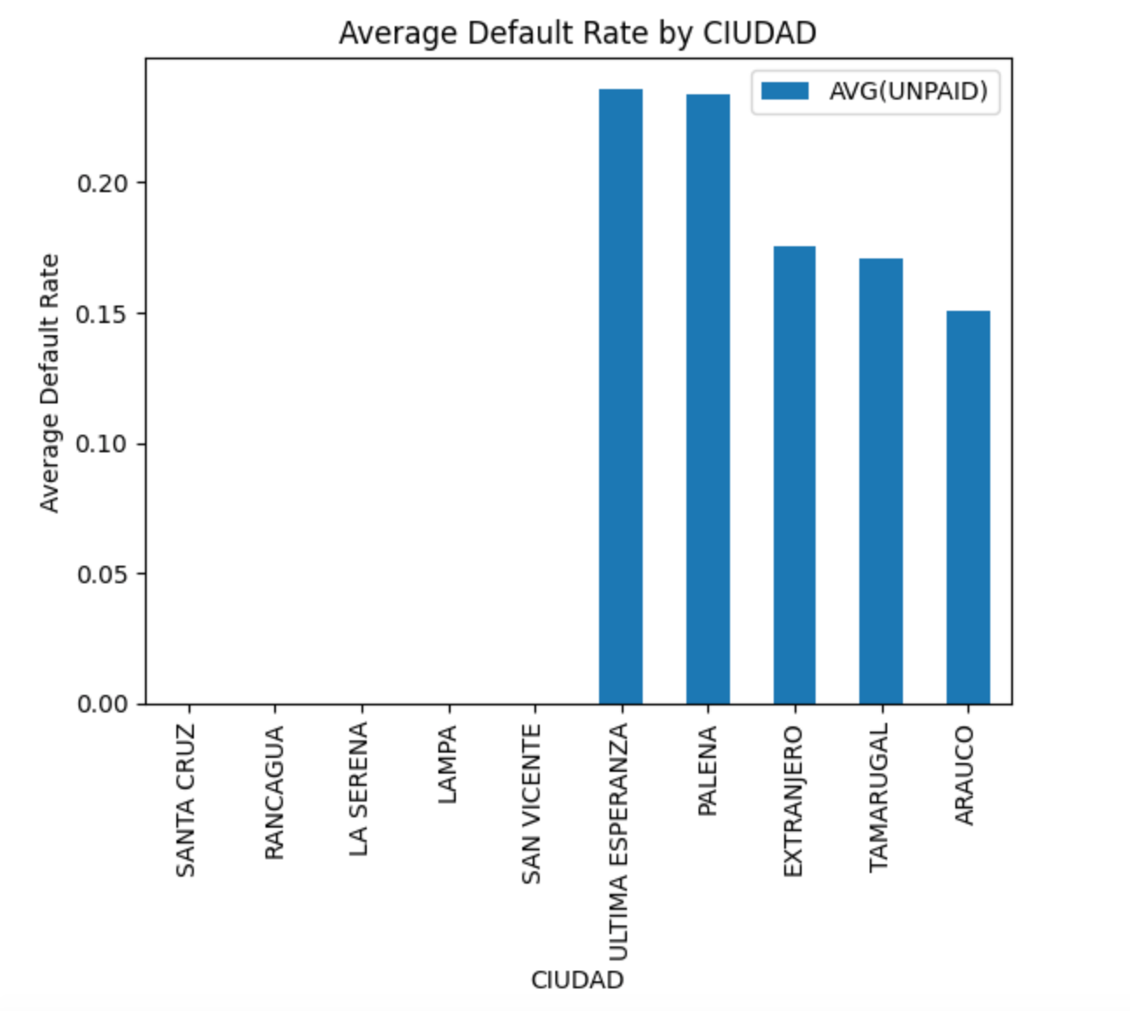
Part 4: Predictive Model
4.2 Cluster Analysis
4.2.1 Variable Selection: Geographical variables

Slide 45
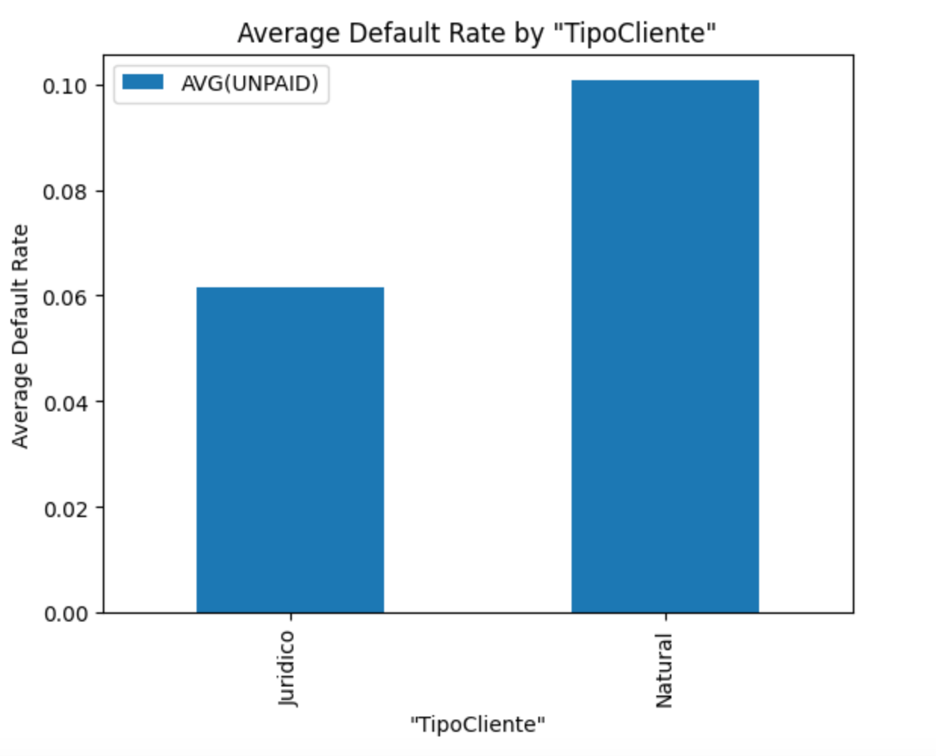
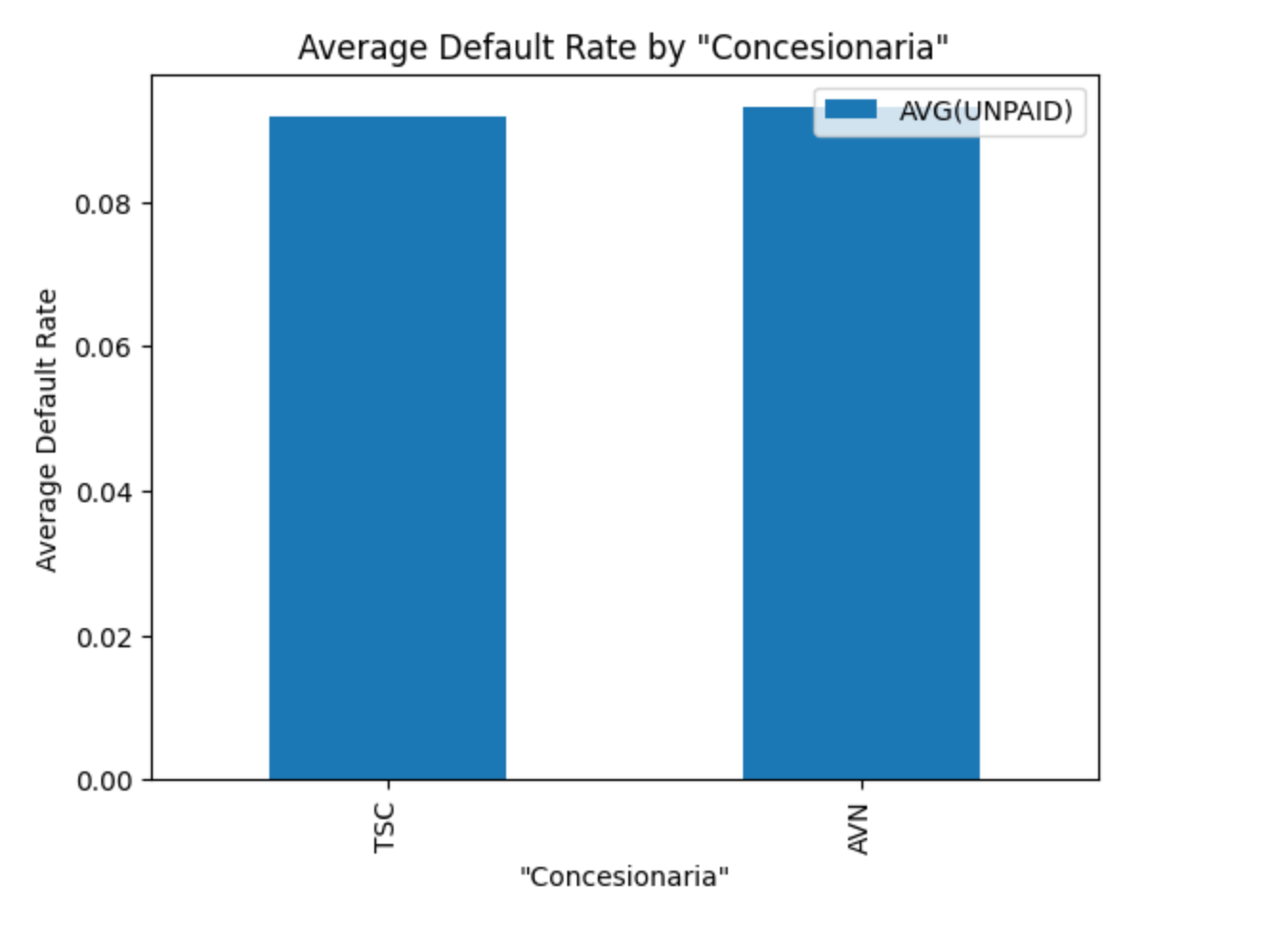
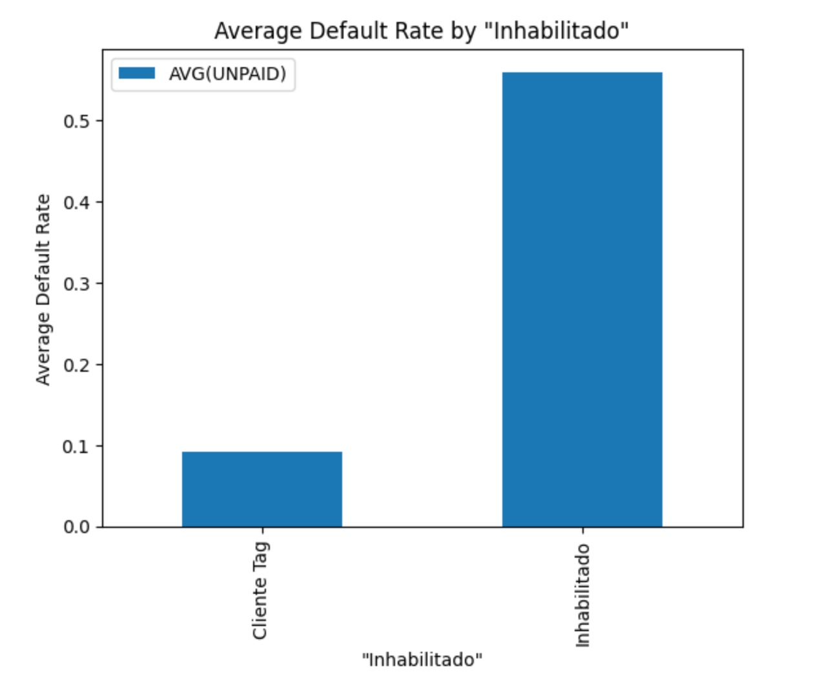
Part 4: Predictive Model
4.2 Cluster Analysis
4.2.1 Variable Selection: Individual-level variables

Slide 46
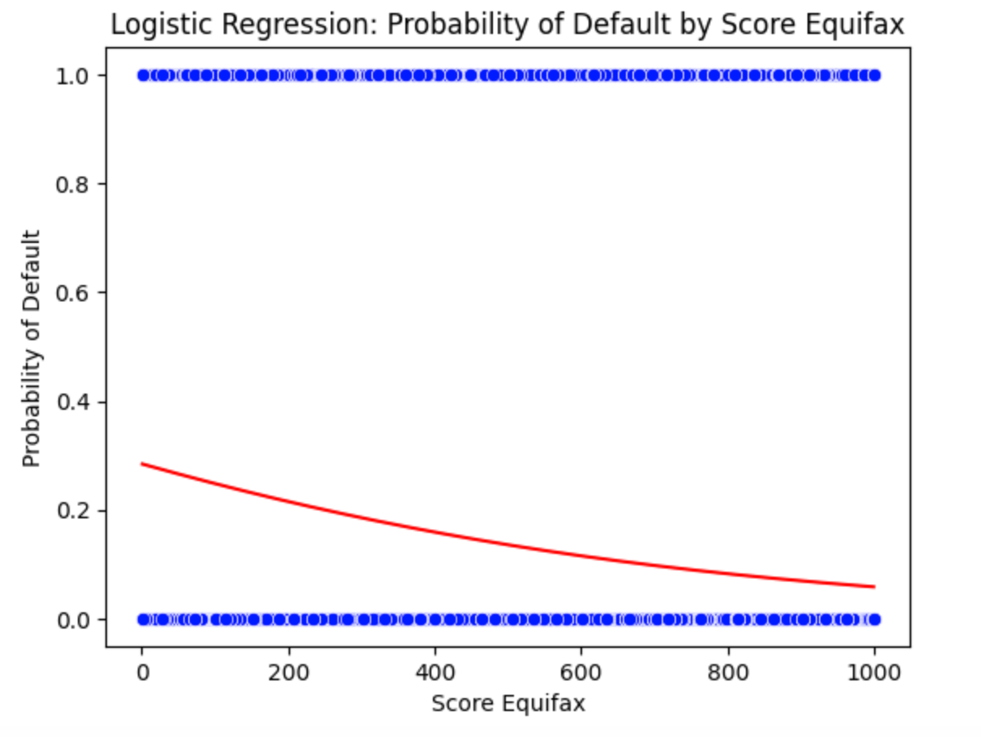
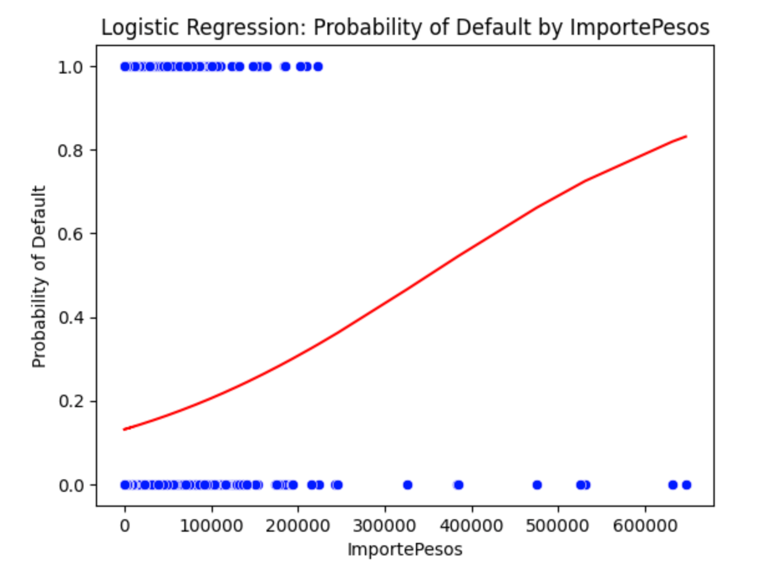
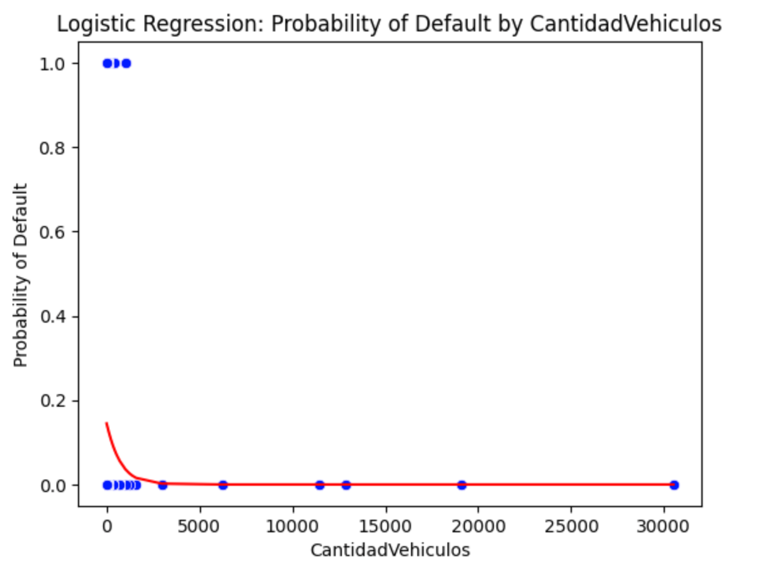
Part 4: Predictive Model
4.2 Cluster Analysis
4.2.1 Variable Selection: Continuous variables

Slide 47
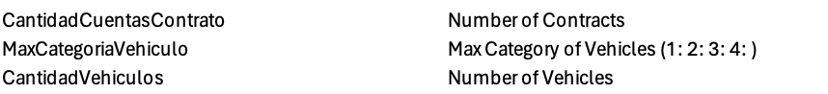


Part 4: Predictive Model
4.2 Cluster Analysis
4.2.1 Variable Selection: Selected variables

Slide 48






Part 4: Predictive Model
4.2 Cluster Analysis
4.2.2 K-means Clustering: 10 clusters - 280 637 users

Slide 49
Part 4: Predictive Model
4.2 Cluster Analysis
4.2.2 K-means Clustering: Description of clusters
Characteristics of cluster 0 (Unpaid rate = 10%)
Average equifax score of 642 (+5,4%)
High Transaction amount : 2755 (+30%)
95% living in REGION 13
Only 1 contract (Candidad cuentas contrado )
Natural Person
Toll operation
Characteristics of cluster 9 (Unpaid rate = 20%)
Average equifax score of 617 (+2%)
High Transaction amount : 676 (-68%)
95% living in REGION 13
3 vehicles owned
Only 1 contract (Candidad cuentas contrado )
Natural Person
Interest operation
Characteristics of cluster 8 (Unpaid rate = 47%)
Average equifax score of 570 (-7%)
Small Transaction amount : 531 (-75%)
92% living in REGION 13
1 or 2 contract (Candidad cuentas contrado )
Natural Person
Collection Cost Operation
Characteristics of cluster 1 (Unpaid rate = 24%)
Average equifax score of 571 (-7%)
High Transaction amount : 2449 (+ 16%)
93% living in REGION 13
2 contract (Candidad cuentas contrado )
Natural Person
Toll Operation
Characteristics of cluster 2 (Unpaid rate = 18%)
Average equifax score of 564 (-8%)
High Transaction amount : 3474 (+64%)
iving in REGION 13, 5, 6 and 7
18 vehicles owned on average
1 or 2 contract (Candidad cuentas contrado )
Legal Entity
60% toll operation, 30% interests

Slide 50
Part 4: Predictive Model
4.3 Next steps with the model
Based on the findings, the model can be improved by the following factors:
Improved city information: We can observe that most of the models are using cities as important features to classify default. And we see that the signs for a few cities is positive and a few negative to predict default. Based on our macro-economic analysis if we’re able to choose a few macroeconomic factors across these cities and include them as an explanatory variable, the model’s performance might improve
Introducing customer demographics: If variables like age, gender, marital status,salaries can be added ensuring minimal bias and fairness, we anticipate it can really help improve prediction
Improved feature engineering: Creating consolidated variables that capture payment behaviour associated with a particular customer and add it to invoice level data.
Training separate models on the identified clusters: Customers have been segmented into clusters and training different models in each customer segment will help us predict defaults better
Time Series Analysis Models: Implementing Time Series Analysis models like ARIMA can help understand default over time better and decipher seasonality trends if any which can be incorporated into the model for a potentially better predictive power
Explainability: SHAP and LIME plots reveal the impact of each feature (strength and direction) on model predictions, such as default probabilities, by showing how influential each variable is. Validating these insights through a business-sense check ensures they align with domain knowledge and intuition, confirming the model's practical reliability

